Slide 1
How inappropriate to call this planet Earth
when clearly it is Ocean
Arthur C. Clark

Slide 2
(ESCI 759/859)
Fall 2011
THIS IS A GRADUATE-LEVEL COURSE
Instructors:
Larry Mayer
and
Jim Gardner
Course Level:
Graduate/Advanced Undergraduate
Prerequisites:
2 semesters calculus and physics and senior
geology major or permission of instructor
Credit Hours:
4
Meeting Times:
Tues
--
Thurs 0940
–
1100 am
Lab
--
Thurs 2 to 4 pm
Classes meet in the
Center for Coastal and Ocean Mapping
Visualization Classroom Room 130
Chase Ocean Engineering Laboratory
Labs meet in computer lab
Seminars meet in upstairs conference room (the Admiral’s Room)

Slide 3
If you are NOT a:
senior geology major
(2) graduate student
or
(3) GEBCO student
DROP THIS CLASS

Slide 4
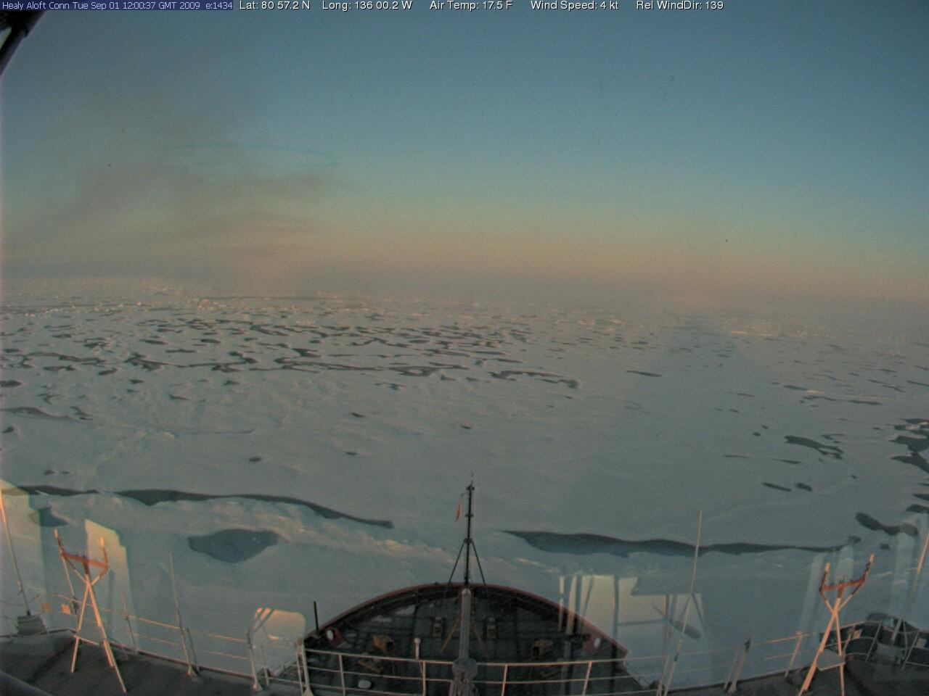
80º 57.2N 136º 00.2W; air temp -8.0º C, wind 4 kts
who are we?
&
who are you?

Slide 5
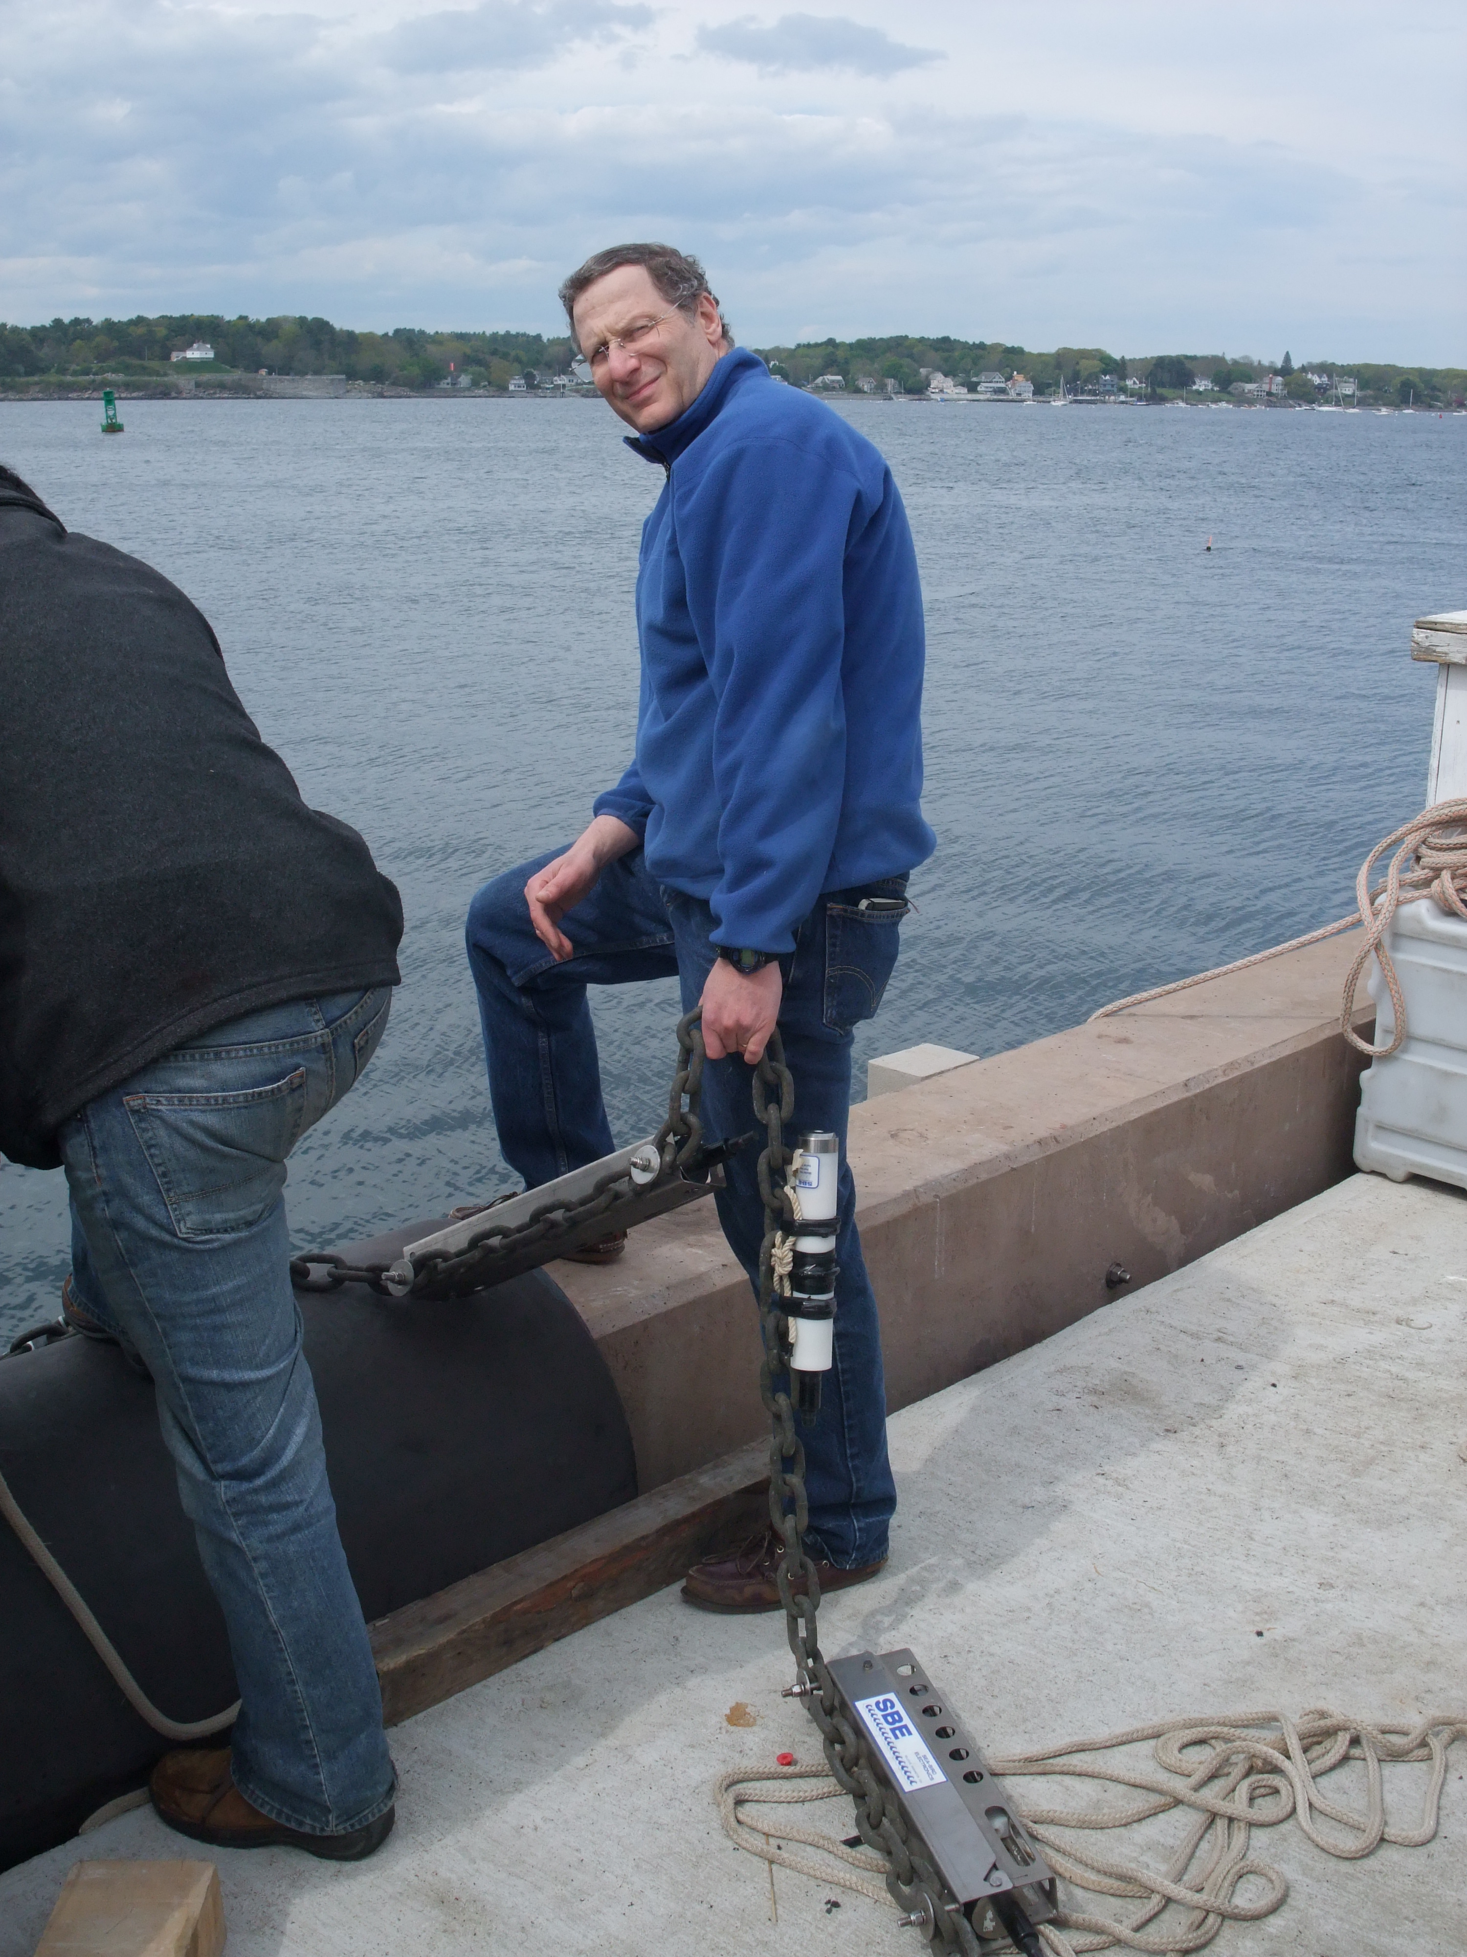
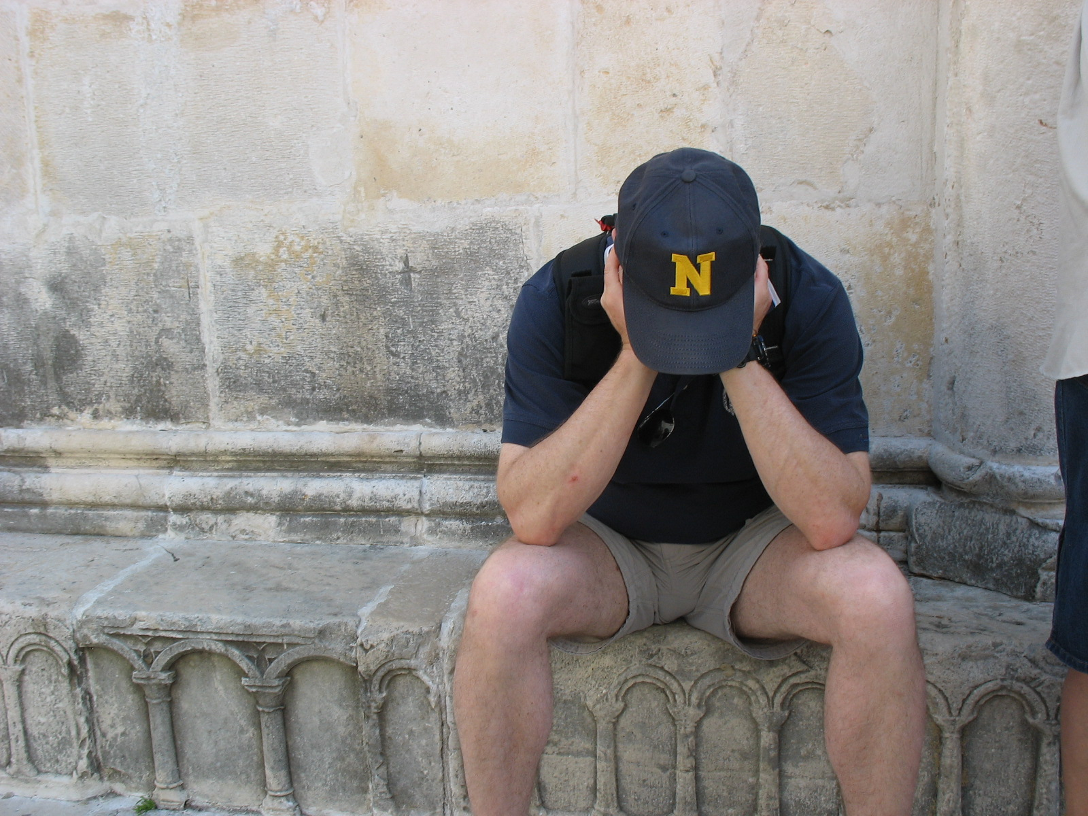
PROF. LARRY MAYER
Ph.D., Scripps Institution of Oceanography (1979)

Slide 6
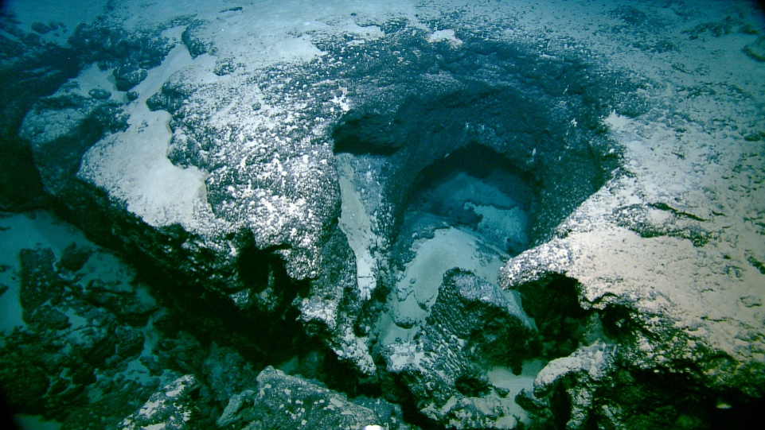
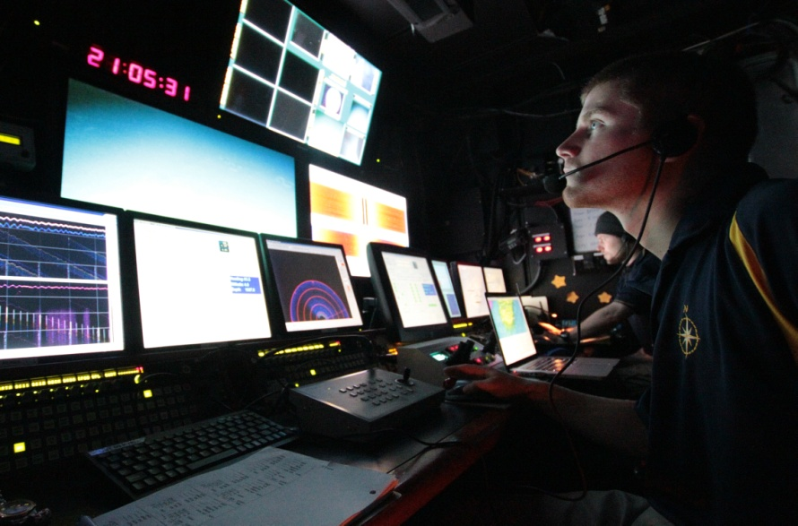
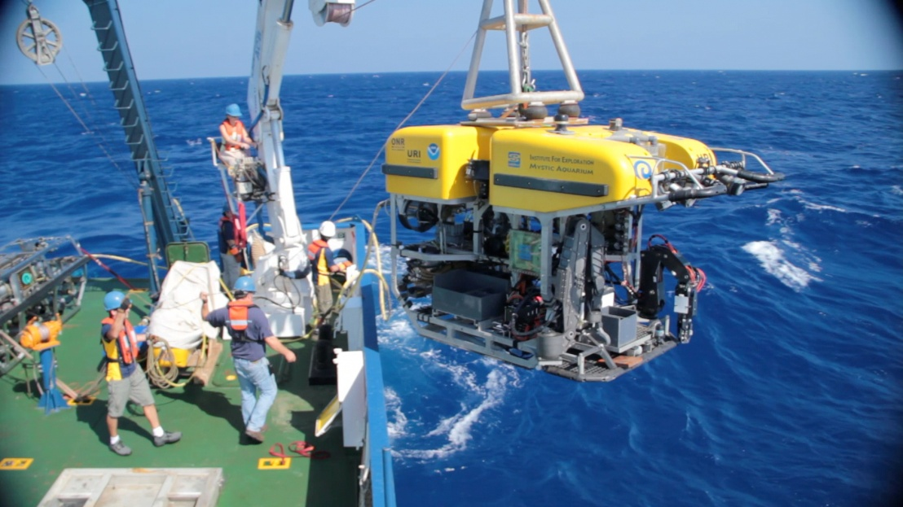
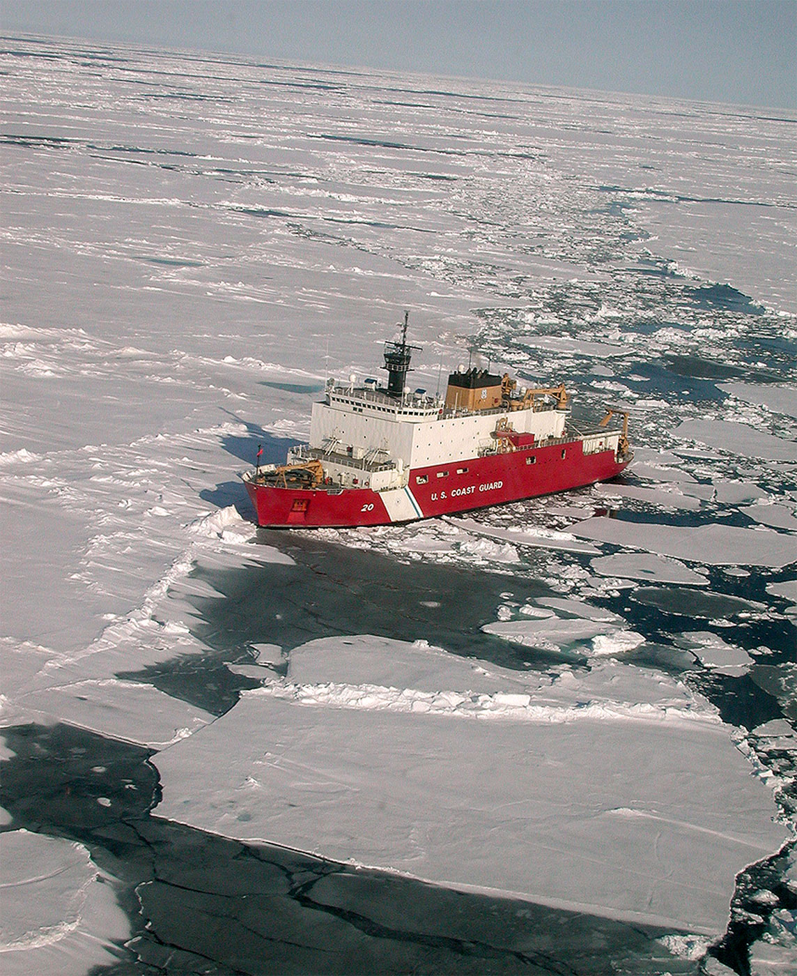
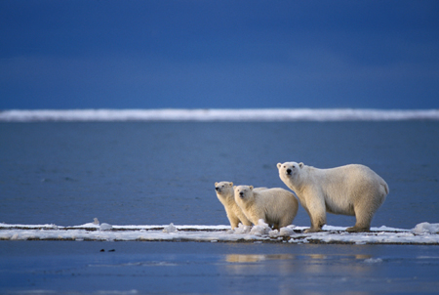

Slide 7
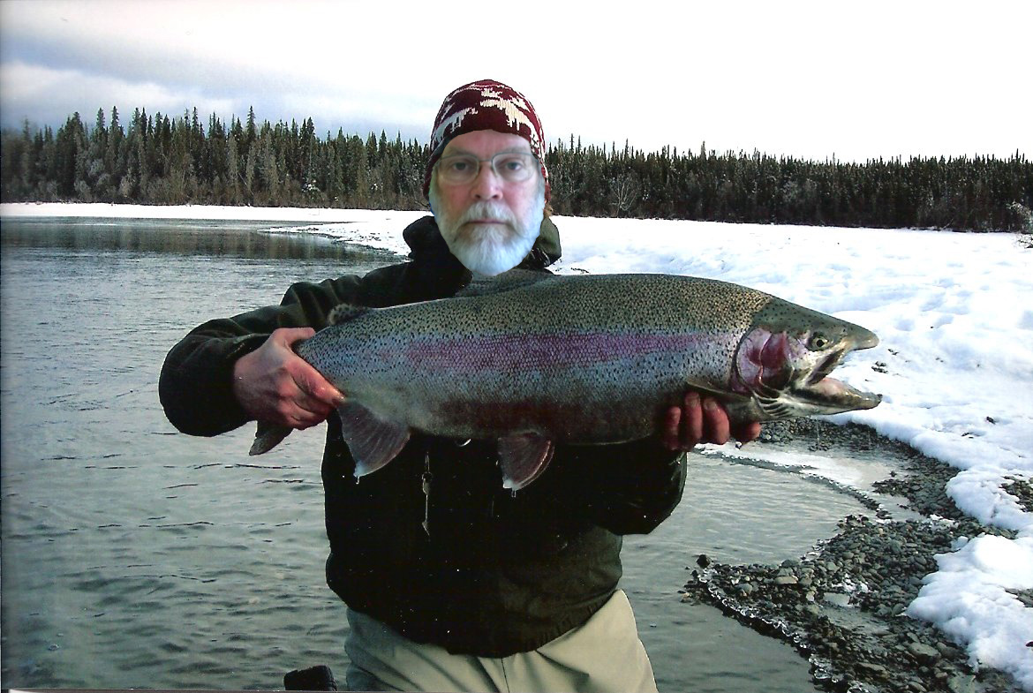
JIM……..
Ph.D., Lamont-Doherty Geological Observatory (1973)
http://www.wired.com/science/planetearth/magazine/1602/mf_continentalshelf?currentPage=2

Slide 8
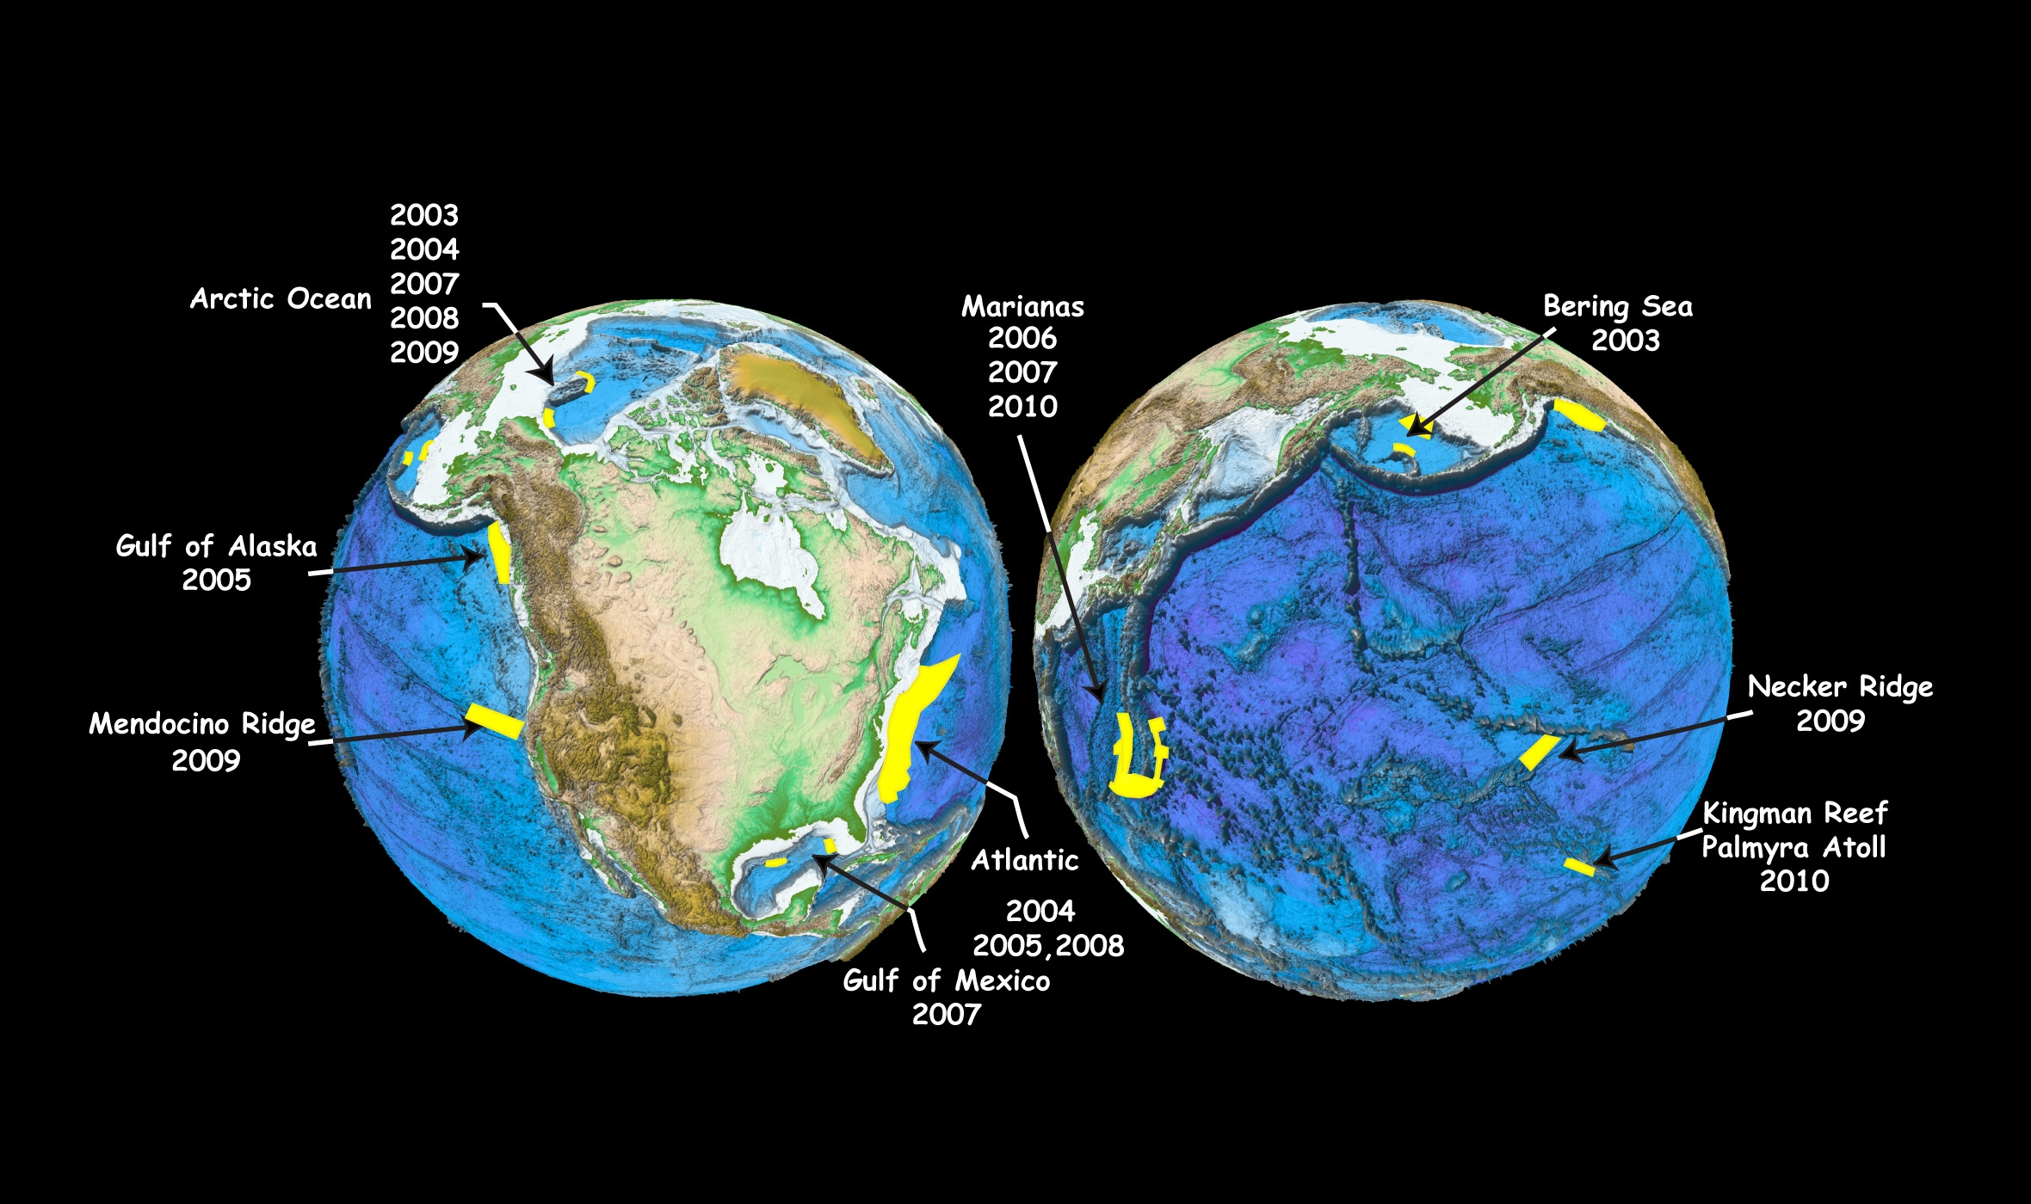
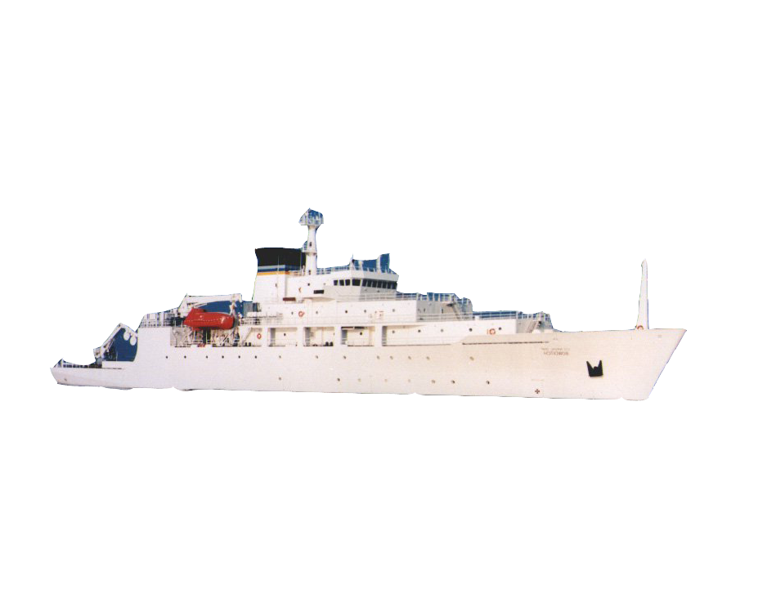

Slide 9
who are you?

Slide 10
Course Format: 2 Lectures/week
1 2-hr Tuesday lab or seminar
student-led seminar discussion most weeks
2 term papers
midterm & final exams
Texts: (Required)
Kennett, J.P., Marine Geology, Prentice Hall, 1982
Jones, E.J.W., Marine Geophysics, Wiley, 1999
Other general texts: Anderson, Roger, Marine Geology, Wiley, 1988
Seibold, E. and Berger, W.H., The Sea Floor, Springer-Verlag, 1982
Burger, H. Robert, Exploration Geophysics of the Shallow Subsurface, Prentice Hall, 1992

Slide 11
Journals (just a sampler - there are more):
Journal of Geophysical Research (CCOM & UNH) Sedimentology (UNH)
Geophysical Research Letters (UNH) Jour. of Sedimentary Res. (UNH)
Geological Society of America Bulletin (UNH) Can. Jour. of Earth Science (UNH)
Geology (CCOM) AAPG Bulletin (UNH)
Marine Geology (UNH) Marine Geodesy (CCOM)
Paleoceonography (CCOM) Reviews of Earth and
Tectonophysics (UNH) Planetary Science (UNH)
Science (CCOM) Earth Science Reviews (UNH)
Nature (UNH) Quaternary Research (CCOM)
Earth and Planetary Science Letters (UNH) EOS (CCOM)
Quaternary Science Reviews Geomorphology (UNH)
Marine Geophysical Research (UNH) Scientific American (CCOM)
New Scientist (CCOM)
Deep Sea Research (UNH)
Plus numerous volume series that hold many articles
Check out reading shelves & books in CCOM libraries

Slide 12
Important historical textbooks to know about
Trask, P.D. (ed.), 1939, Recent Marine Sediments, Dover Publ. Inc., NY
Shepard, F., 1948 (1973), Submarine Geology, Harper & Row, NY
Kuenen, Ph. H., 1950, Marine Geology, John Wiley & Sons, Inc., NY
Heezen, B.C., Tharp, M. and Ewing, M., 1959, The Floors of the Oceans,
Geological Society of America Special Paper 65.
Emery, K.O., 1960, The Sea off Southern California, John Wiley & Sons, Inc., NY
Hill, M.N. (ed.), 1963, The Sea, vol. 3, 4 & 7 John Wiley & Sons, NY
Menard, H.W., 1964, Marine Geology of the Pacific, McGraw-Hill Book Co., NY
Shepard, F.P. and Dill, R.F., 1966, Submarine Canyons and Other Sea Valleys,
Rand McNally & Co., Chicago
Deep Sea Drilling Project Initial Reports, 1968-1985, vol. 1 thru 96
Heezen, B.C. and Hollister, C.D., 1971, The Face of the Deep, Oxford
Univ. Press, London
Lisitzin, A.P., 1972, Sedimentation in the World Ocean, Soc. Econ. Paleo.
& Mineral (SEPM) Special Publ. 17.
Ocean Drilling Program Scientific Results, 1985-2003, vol. 100 thru 210
(important names in the early years of the field)

Slide 13
Seminar Labs: Approximately once each week there will be journal articles assigned for reading. We will all read a couple of articles. At the seminar session, one of you will be asked to lead the discussion of each article. This means that each of you must be prepared to lead the discussion of all articles.
Computer Labs: A couple of labs will be computer labs. They will concentrate on teaching you how to download data from the web and generate seafloor maps from the downloaded data.

Slide 14
Assessment: Grades will be based on:
Mid-term exam = 30%
Final exam = 30%
Two term papers (15% each) = 30%
Seminars, class participation
and assignments = 10%

Slide 15
Term papers:
Purpose: (1) To delve more deeply into a subject than is covered in class and (2) to gain experience in the process of scientific writing.
• Draft manuscripts must be submitted to Connors Writing Center & instructors 2 weeks after assigned
• Revised manuscript must reflect suggestions
from Connors Writing Center
• Timing: 2 weeks for draft, 2 weeks for
revision. No late papers accepted

Slide 16
UNH Blackboard
Know how to login? (ask Abby)
Lecture PowerPoints are posted
after each class
Lab data
Take-home exams

Slide 17
Course Overview
A BRIEF HISTORY OF MARINE GEOLOGY
Early mapping, positioning and sampling techniques
The echo sounder, transducers, piezoelectricity
Why we get echos from the seafloor
The Heezen and Tharp bathymetry maps
PHYSIOGRAPHY – Defining the Shape of the Seafloor
Observations based on early mapping
Major physiographic provinces and bathymetric features
Modern mapping and positioning techniques
Deep-towed instrumentation and navigation
Multibeam bathymetry and backscatter
Autonomous underwater vehicles (AUVs)
GPS and DGPS positioning
Satellite Altimetry

Slide 18
EARTH’S INTERIOR – Defining the Structure of the Earth
Methodologies
Reflection seismology
Refraction seismology
The Internal Structure of the Earth
Geophysical Evidence
Geological Evidence
Various Geophysical Methods
Gravity
Magnetics
THE OVERIDING PARADIGM: PLATE TECTONICS
Early geologic evidence
Geophysical evidence
Driving mechanisms
Divergent systems
Convergent systems

Slide 19
MARINE SEDIMENTS and SEDIMENT TRANSPORT
Sources of Marine Sediment
Approaches to Sediment Classification
Sampling techniques and DSDP/ODP
Physics of Sediment Transport
NEARSHORE PROCESSES
Beaches and Barriers
Deltas and Estuaries
SEA-LEVEL HISTORY
CONTINENTAL MARGINS
Building the Shelf and Slope
Slides and Slumps
Gravity Flows and Turbidity Currents
Submarine Canyons

Slide 20
SUBMARINE FANS, RISES and ABYSSAL BEDFORMS
STRATIGRAPHY
NON-BIOGENOUS DEEP-SEA SEDIMENTS
BIOGENOUS DEEP-SEA SEDIMENTS
PALEOCEANOGRAPHY & CLIMATE CHANGE
THIS IS RIDICULOUS
but....

Slide 21
We’re gonna give it a shot! However, . . . . .
PRIMARY OBJECTIVE -- to gain a basic understanding the earth of which the seafloor represents 75% of the area
-- to provide you with a basic understanding of the major features of the seafloor and the processes responsible for them.
-- if I describe an environment, you can tell me what sort of morphology or sediment cover you would expect
(i.e., continental slope)
-- if you look at a map of the seafloor -- you have a basic understanding of why you are seeing what you see
(i.e., 30°N/40°W)

Slide 22
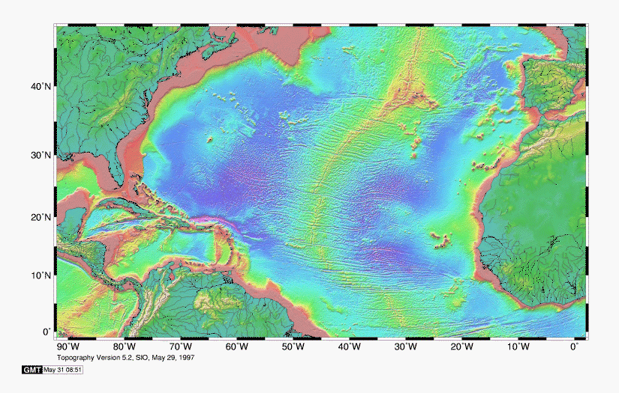
http://topex.ucsd.edu/marine_topo/mar_topo.html

Slide 23
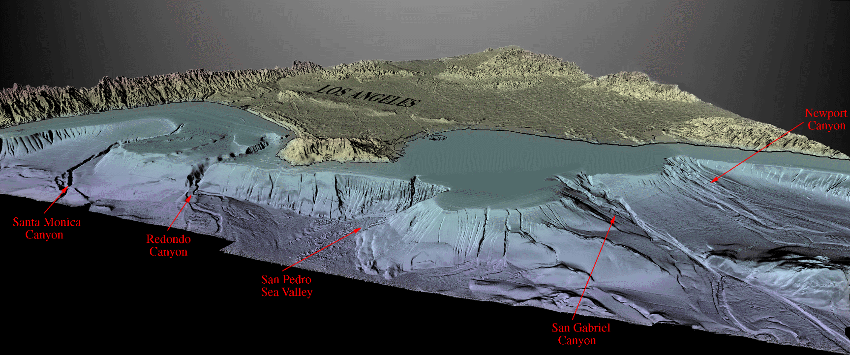
http://geology.wr.usgs.gov/dds/dds-55/pacmaps/la_index.htm

Slide 24
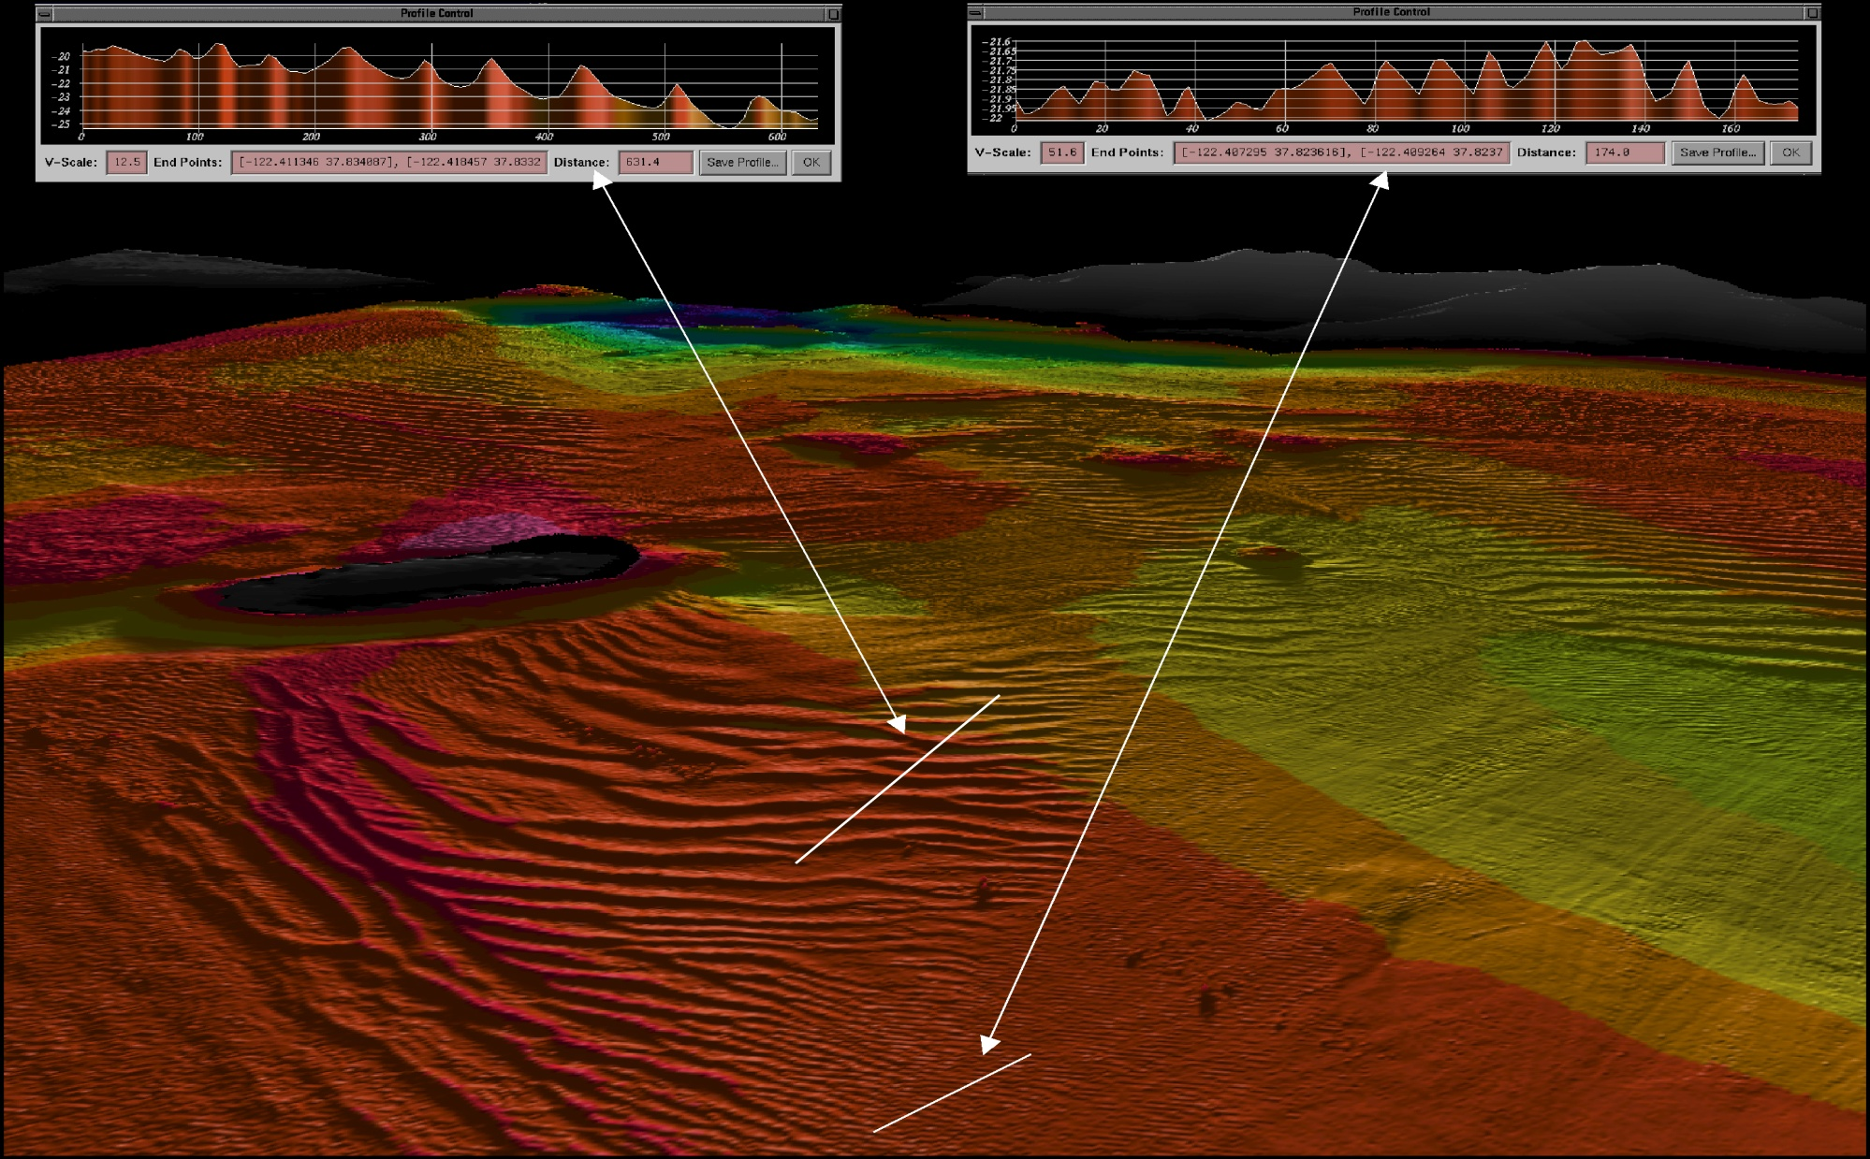
San Francisco Bay, CA
http://walrus.wr.usgs.gov/pacmaps/sf_index.html

Slide 25
From Ocean Chemistry and Deep-Sea Sediments, Open University Press

Slide 26
Like much in earth science, the morphology and sampling is a key to understanding the processes
Unlike terrestrial earth science, this morphology (the seafloor) is hidden away from us by all that bothersome water
Therefore, we need to use remote-sensing techniques for both mapping and sampling
We’ll start our exploration by looking at how these techniques have developed

Slide 27
RequiredReading for next class:
Kennett, pg. 23 – 39
Check out websites:
http://www.earth.ox.ac.uk/~tony/watts/MARGIN/MARGIN.HTM
http://www.coast-nopp.org/visualization_modules/physical_chemical/basin_coastal_morphology/principal_features/continental_margins/margins.html

