Slide 1
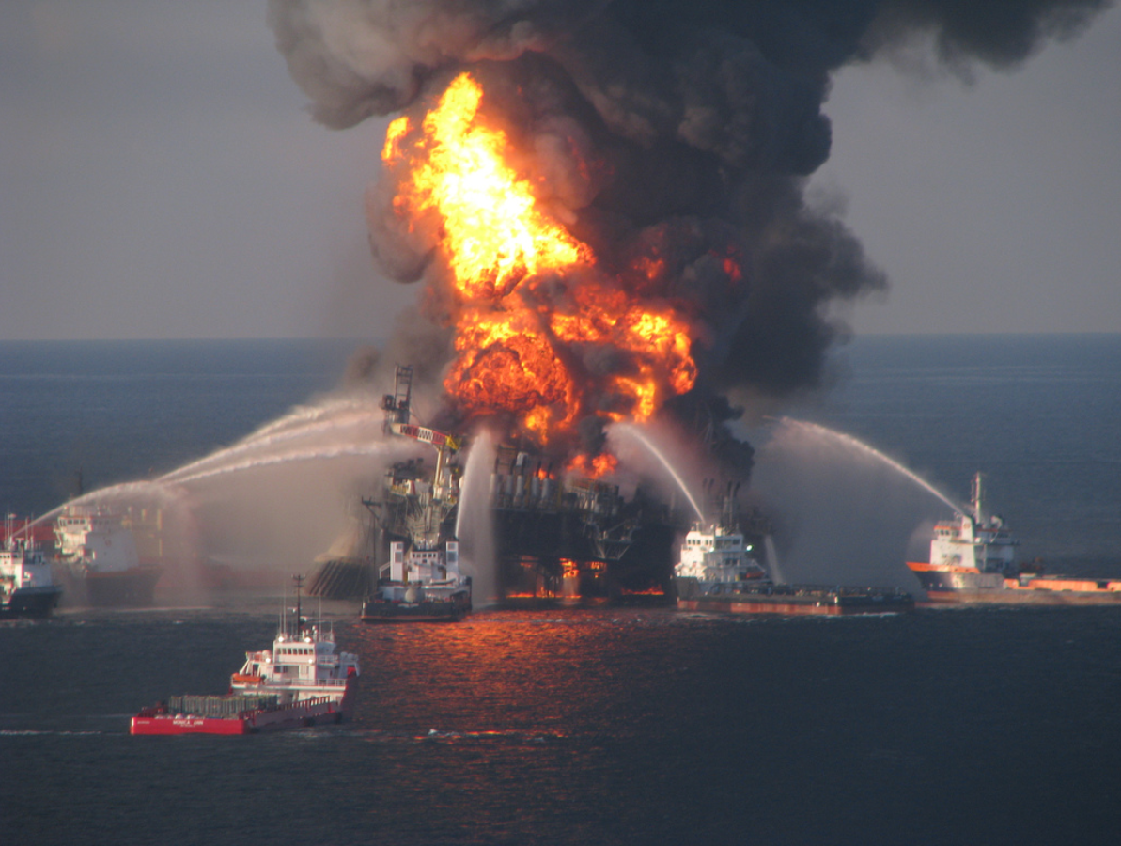
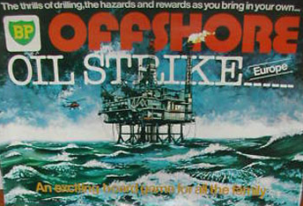
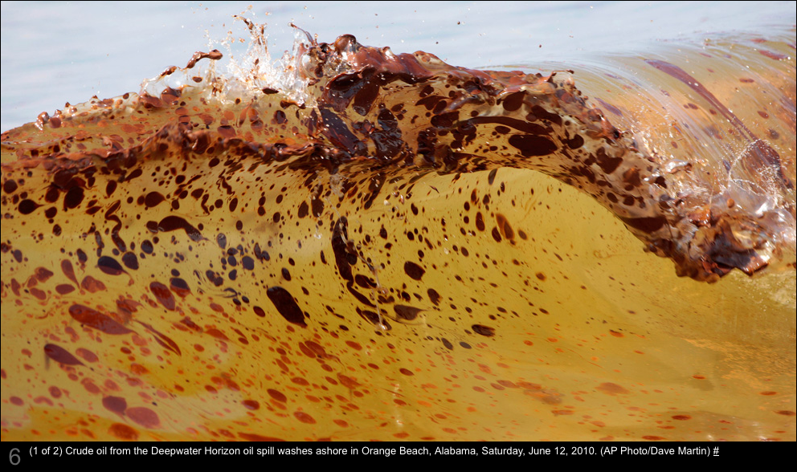
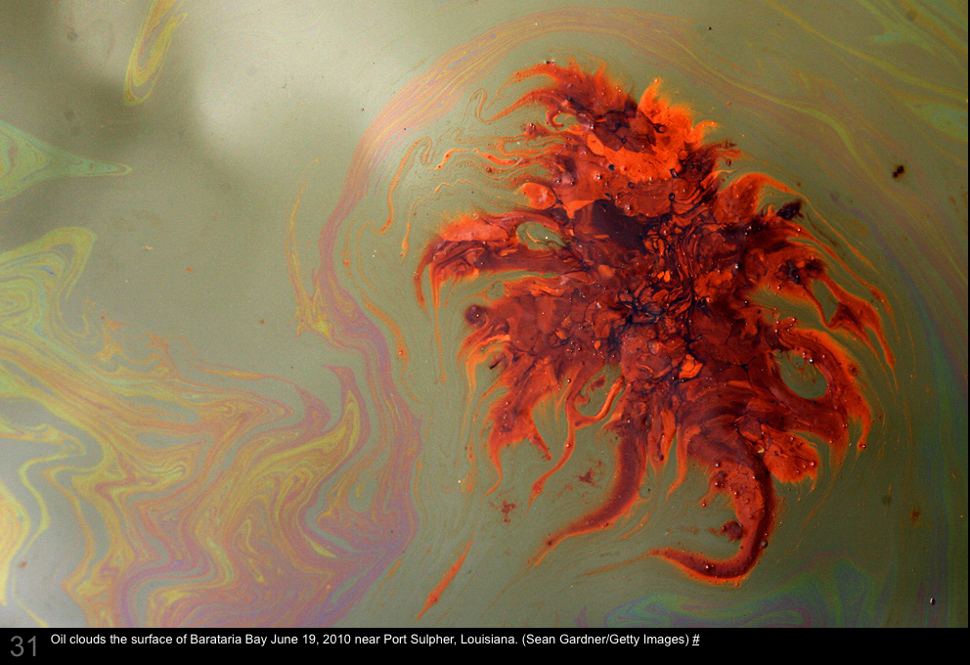
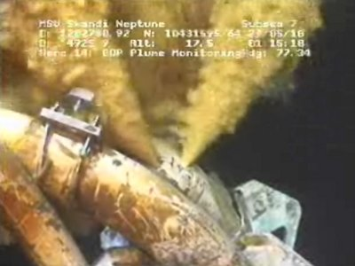
Response Logistics ERMA & GeoPlatform
Kurt Schwehr
19-Jan-2011
http://schwehr.org
Notes:
This talk represents my opinions only. The material here has not been reviewed by NOAA or the USCG. I worked on the Deepwater Horizon incident from NH, but never visited the Gulf of Mexico during April – Sep 2010. As such, I am likely unaware of much of what transpired in the command centers and on the water.
http://creativecommons.org/licenses/by-nc-sa/3.0/
Background image from http://www.flickr.com/photos/deepwaterhorizonresponse/
Top right is an image of the BP board game from the 1970’s posted on http://gcaptain.com
2nd from the top is an AP image by Dave Martin, used without permission
3rd from the top is an image from Getting Images/Sean Gardner, used without permission
Bottom right image is a screen capture from the BP video feed during the attempted top kill.

Slide 2
Credits
Rob Braswell, Allison Bailey, Jordan Chadwick, Phil Collins, Chander Ganesan, Stanley Glidden, George Graettinger, Michael Greer, Michele Jacobi, Nancy Kinner, Steven Knight, Bob St. Lawrence, Kathy Mandsager, Amy Merten, Aaron Racicot, Tracy Ross, Kari Sheets, Ben Shorr, Dane Springmeyer
And many others from NOAA (especially OR&R, nowCoast, WOC), USCG, UNH (CRRC, CCOM, Morse Hall, …), and many more
Notes:
Many people contributed to the code, material, time, and money to the development of ERMA and the data sources that drive the system. There are too many to name here.
I am sure I have missed a number of key people. I apologize to anyone that I have missed. I have not had a chance to meet most of the people despite spending months of time with some of them on IRC chats at all hours.
http://www.crrc.unh.edu/erma/index.html

Slide 3
Acknowledgement of Funding / Conflict of Interest
Received approximately $65K from BP in 2004 for my PhD research
I have not signed any Non-Disclosures relating to the Deepwater Incident
This represents only my opinions
I worked remotely from New Hampshire on the Deepwater Horizon spill
Notes:
It is important to state any possible conflicts of interest. I would like to be as open as possible about my background so that readers can make their own judgment as to if I am biased. Much of my time recently has been funded by NOAA’s Office of Coast Survey (OCS), the Gateway/Neptune LNG terminals through Cornell, and NASA JPL. I have not received any funding through the USCG.

Slide 4
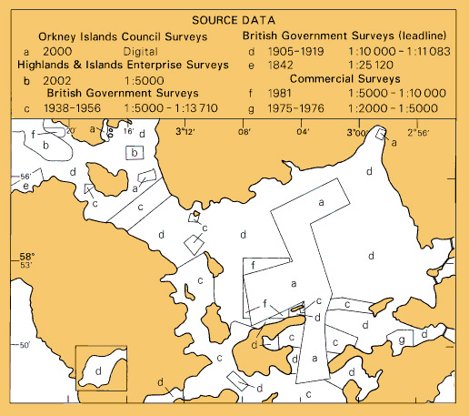
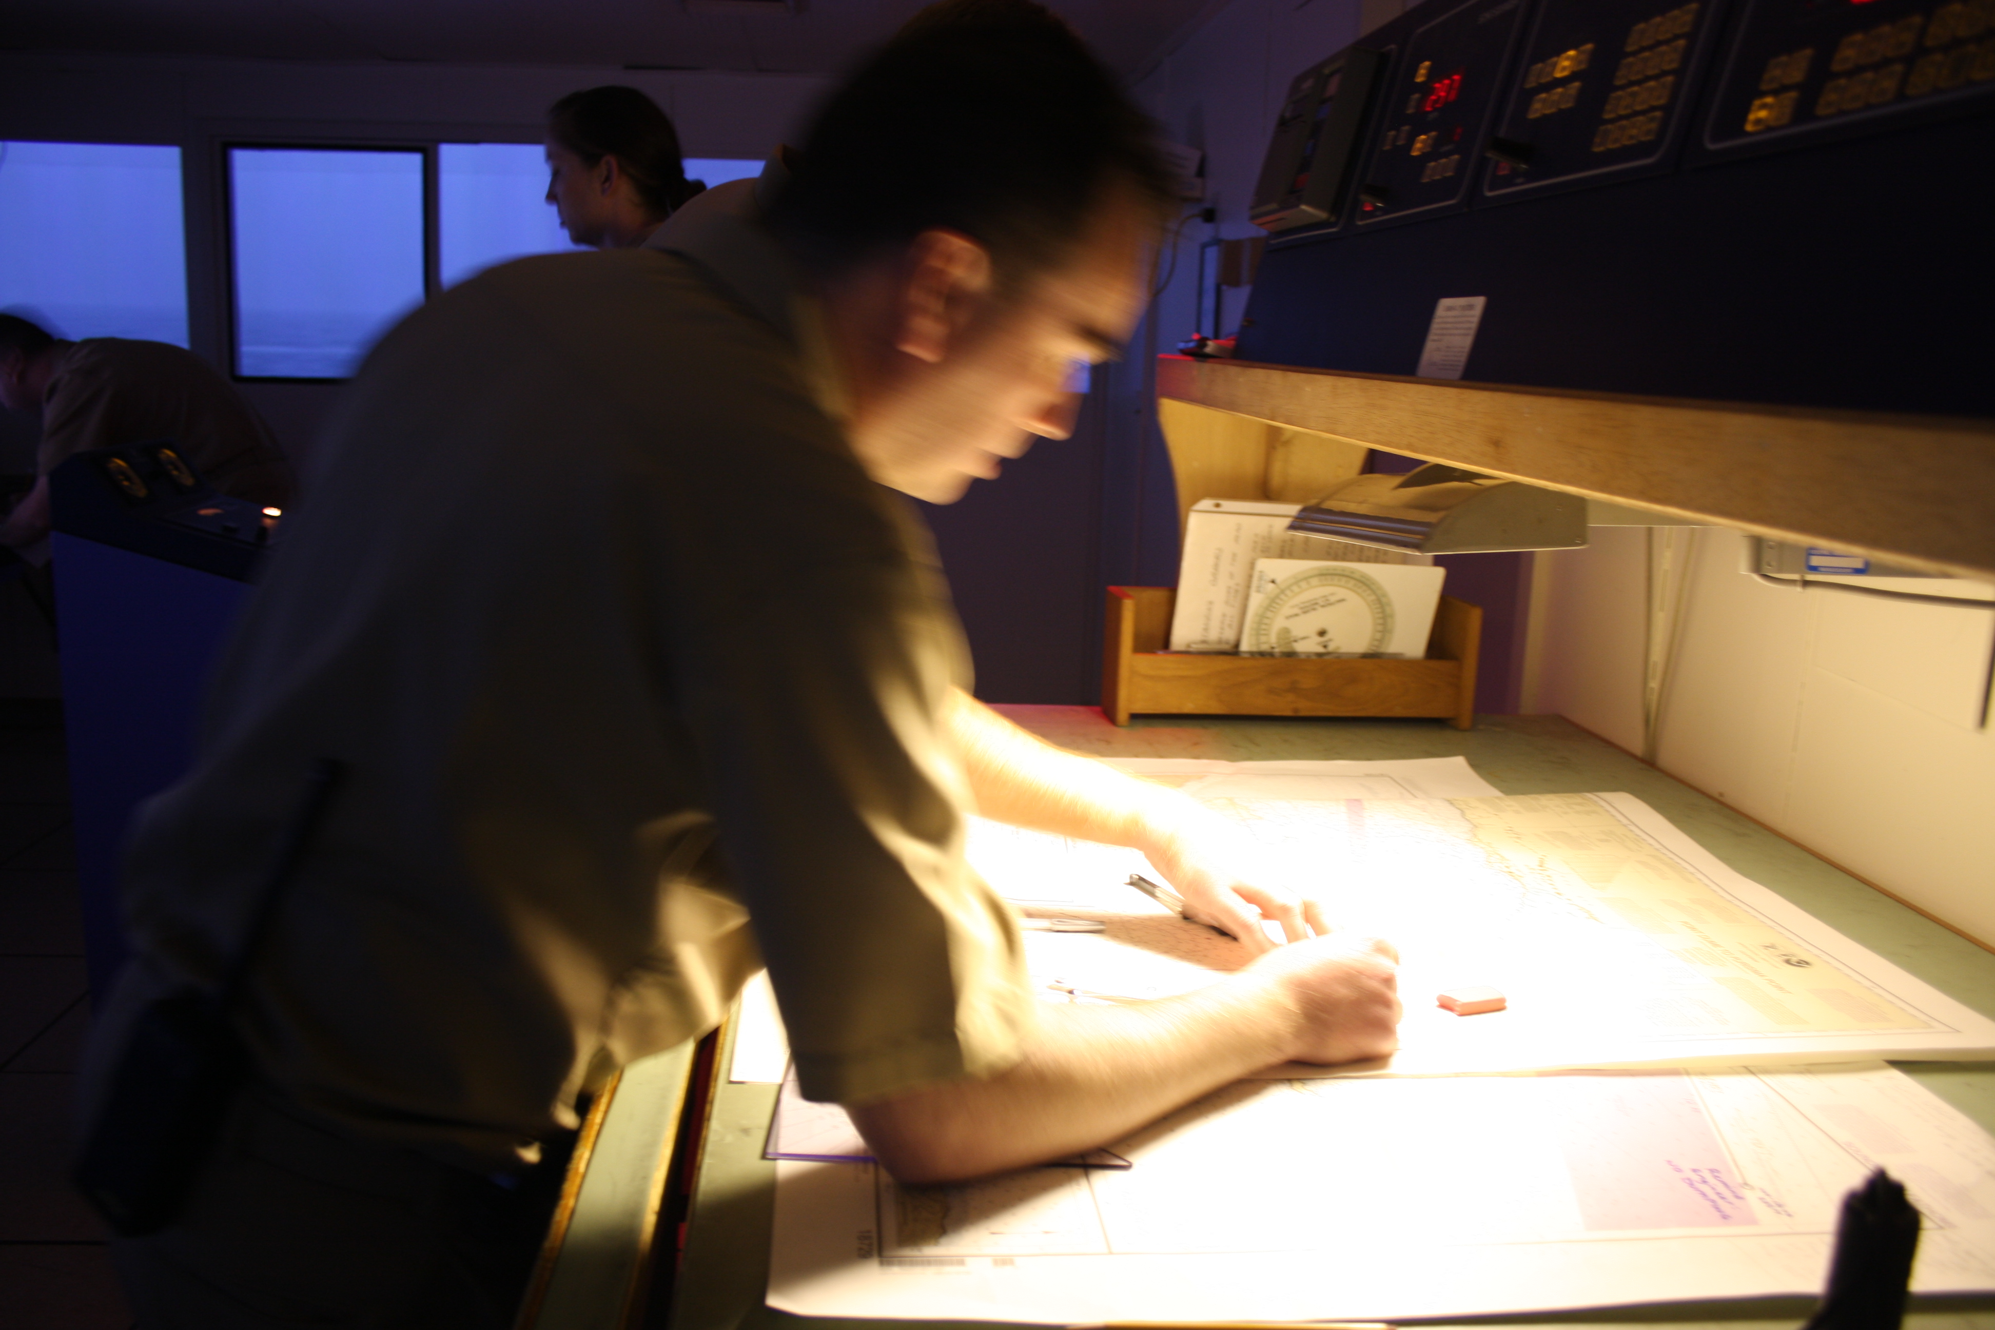
Notes:
Mariners have been evaluating risk for as long as there have been ships at sea. Shown here is a “source data diagram” from a British Admiralty chart. Mariners are supposed to used the date of the survey to infer how confident they should be about how accurately the chart represents the current bathymetry in that particular area. It’s a start, but it nearly impossible for a mariner to make any quantitative assessment of risk of a planned route using a source data diagram. The inset photo shows NOAA Cdr Shep Smith verifying the “ship’s” position in a simulator room at Kings Point Maritime Academy.
Photo by Kurt Schwehr

Slide 5
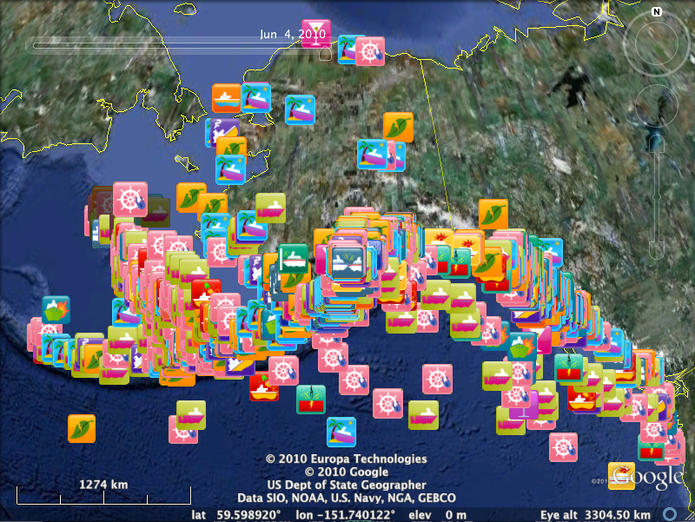
USCG MISLE
Incident Database
2001-2010
Notes:
This is the public version of the USCG Marine Information for Safety and Law Enforcement http://en.wikipedia.org/wiki/MISLE
http://schwehr.org/blog/archives/2011-01.html#e2011-01-12T15_28_32.txt
http://marinecasualty.com/data/MCDATADISC2.zip
Go to the Homeport site: http://homeport.uscg.mil/
Once there click on the following links on the left frame of the page.
Investigations
Marine Casualty/Pollution Investigations
Marine Casualty and Pollution Data for Researchers

Slide 6
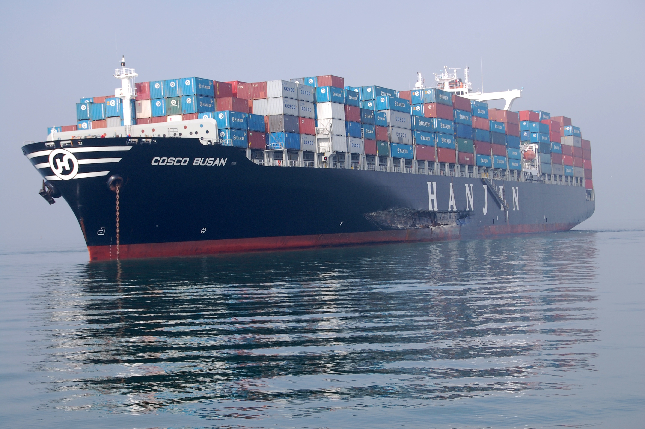
Cosco Busan
7-Nov-2007
Notes:
The Cosco Busan received a huge amount of press time due to occurring in the San Francisco Bay – a densely populated area. Quick response has the potential for many incidents to greatly reduce the environmental impact.
http://en.wikipedia.org/wiki/COSCO_Busan_oil_spill 7-Nov-2007 53,500 USgal (203,000 l) of bunker fuel
Image from USCG

Slide 7
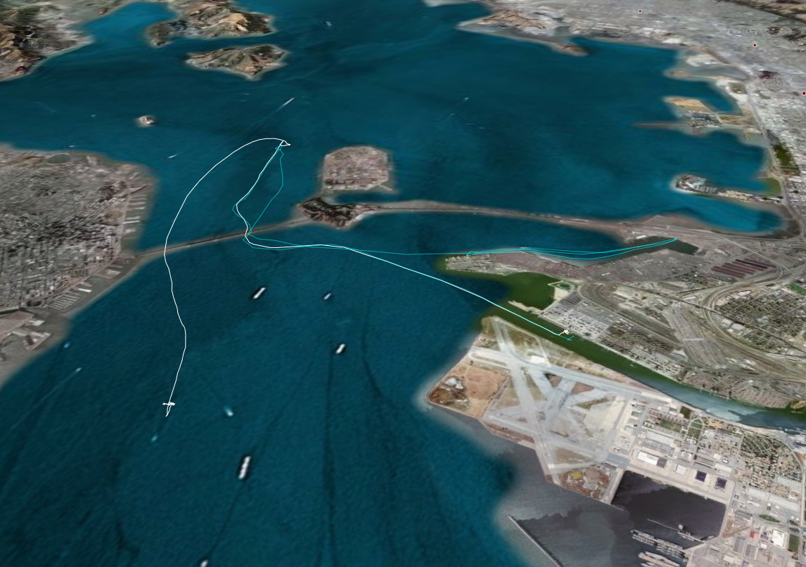
Cosco Busan and the tug Revolution
Cosco Busan, Nov 2007
Automatic Identification System (AIS)
Notes:
With new requirement for many vessels to carry Automatic Identification System (AIS) transceivers, the community can now track vessels in real time and analyze what happened after the fact. Surprisingly in this case (2007), the USCG asked for a copy of my visualization. This surprised me as several USCG officers had previously informed me that they had this capability available to them through MISLE. This led me to question if MISLE was capable of handling emergency response. Not only can non-USCG staff not view the interface, it appeared to not have the capabilities required by the internal USCG users.
USCG RDC AIS feed with 1 sample per minute viewed in Google Earth. Processed with my noaadata software.
Image by Kurt Schwehr

Slide 8
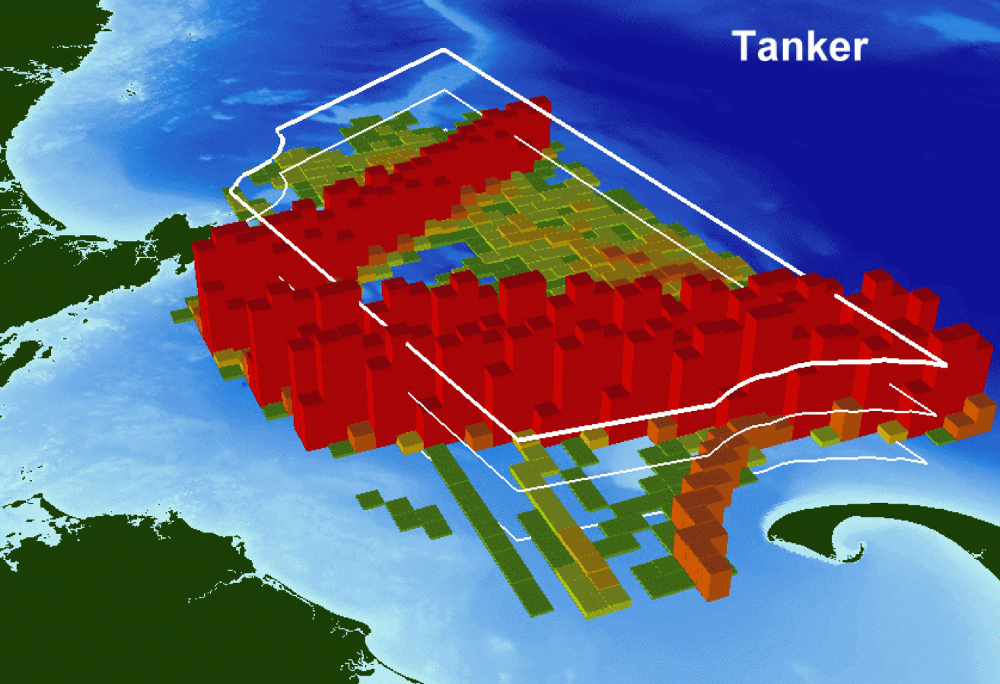
Notes:
Here is a visualization of tanker traffic coming in to Boston, MA through the Stellwagen Bank National Marine Sanctuary based on AIS ship traffic recorded for an entire year (2006). If we know where ships are traveling, we can evaluate the likely impact of those vessels and what the chances of an incident are.
Data processing by Kurt Schwehr. Visualization by Michael Thompson.
Hatch, L., C. Clark, R. Merrick, S. Van Parijs, D. Ponirakis, K. Schwehr, M. Thompson, D. Wiley, Characterizing the Relative Contributions of Large Vessels to Total Ocean Noise Fields: A Case Study Using the Gerry E. Studds Stellwagen Bank National Marine Sanctuary, Environmental Management, 42(5), 735-52, Nov 2008.
http://vislab-ccom.unh.edu/~schwehr/papers/hatch2008-vessel-noise.pdf

Slide 9
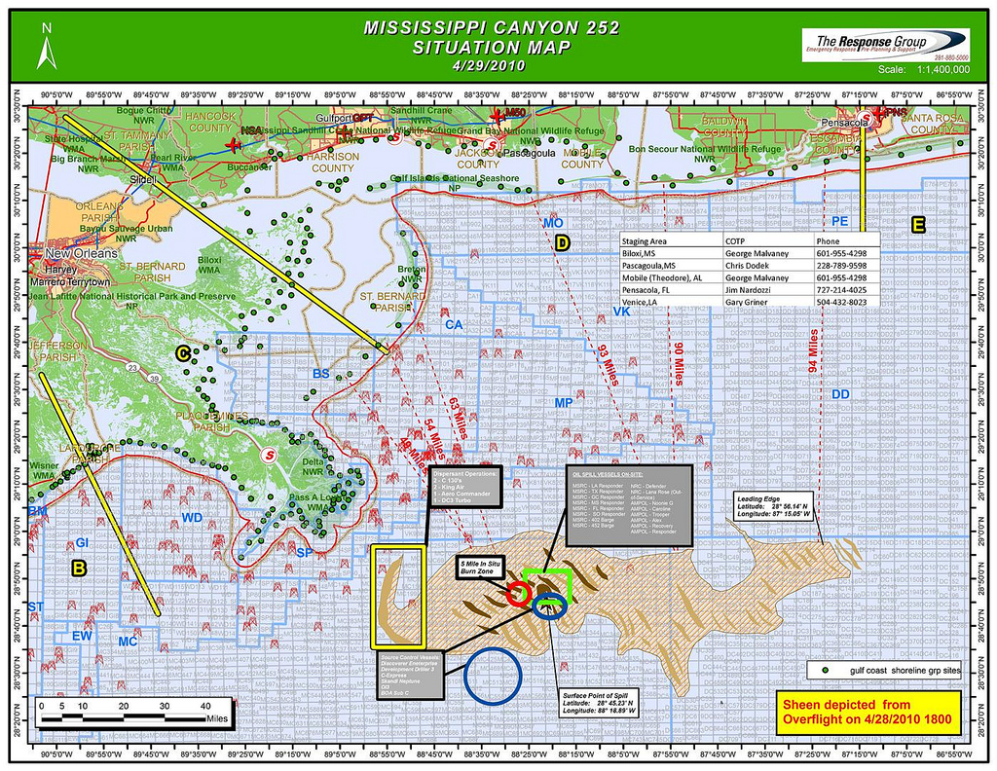
Notes:
The worst problem with these kinds of documents is that they are typically printed. Note here that the oil on the water comes from an overflight that occurred on April 28. The situation map was then created on April 29. If the document was then distributed via email and handouts, people may be getting that information over the next 24-48 hours. At the rate that oil is likely to move around in the ocean, how long is this information likely to be relevant?
http://www.flickr.com/photos/deepwaterhorizonresponse/4578070653/

Slide 10
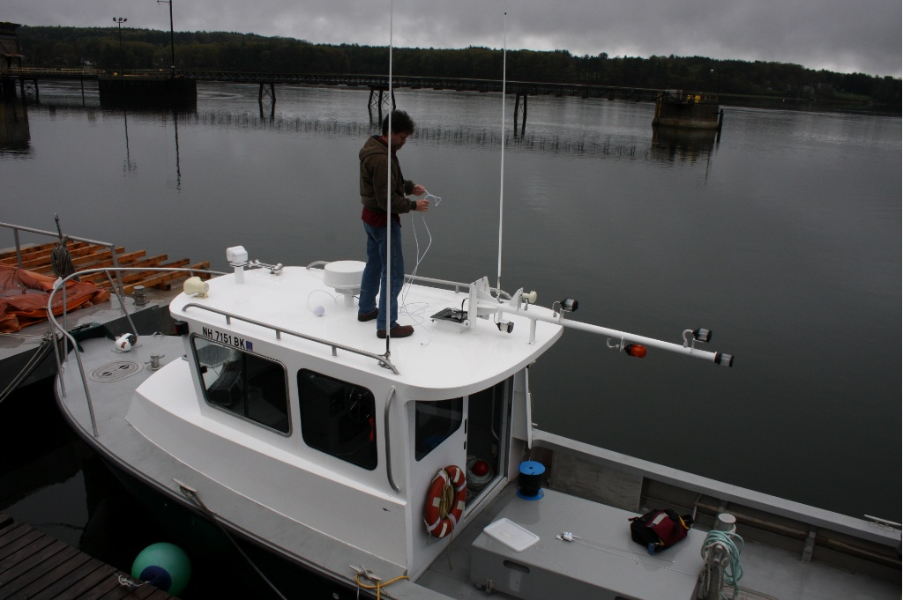
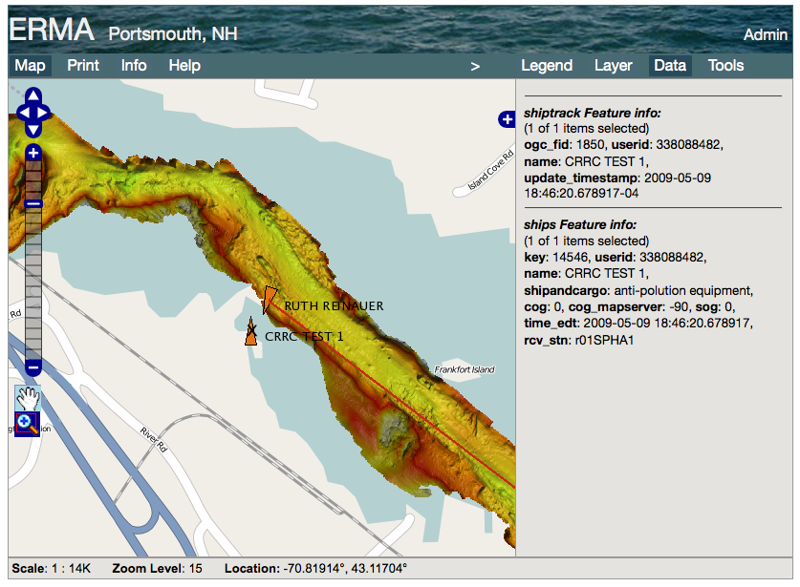
Notes:
However, one problem with AIS is that not all vessels are outfitted with AIS. Small pollution response vessels in the US are not currently required to carry any AIS equipment. We outfitted two Portsmouth Towing response vessels with Class B transceivers so that the command center can track them during boom deployment operations.
Photo by Kurt Schwehr

Slide 11
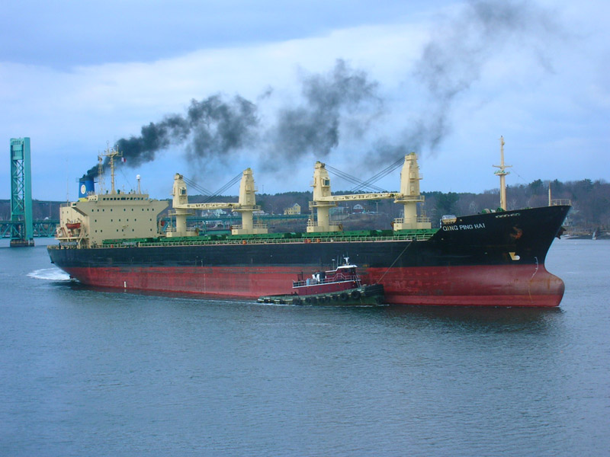
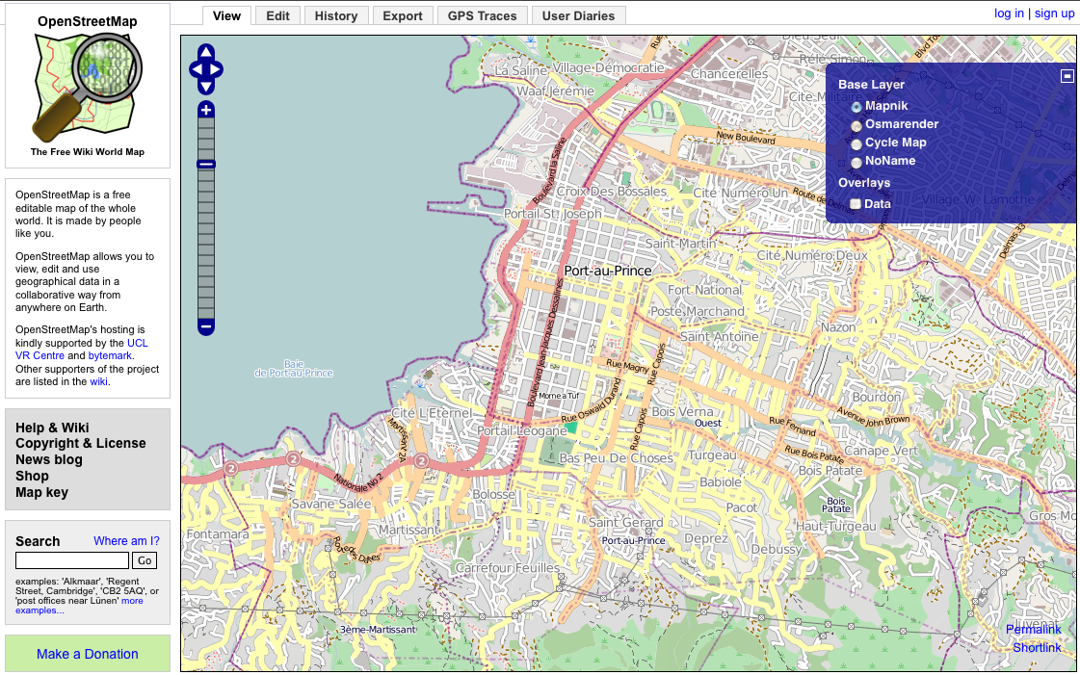
Open Source Tools / Open Protocols
OpenLayers
Open Street Map (OSM)
gdal/ogr
Mapserver
FeatureServer
PostgreSQL / PostGIS
Apache/Django
noaadata/libais for ship tracking
Trac/SVN/git/Python/Perl/Fink/Debian Linux
Nagios
IRC – irc.freenode.net
WMS, WFS, WCS, KML, GeoRSS
Notes:
For ERMA, we attempted a fundamental paradigm shift. We focused on a system built around OpenSource software and open protocols to allow the system to be much more flexible and to allow us to see the code for any portion of the system. “Pay walls” can hinder an environmental response at the most time critical portions of the incident. We wanted to avoid any software license restrictions that might hamper the growth, scaling, or distribution of the ERMA architecture.
A great example of the gained flexibility can be seen with Open Street Map (OSM). If during an incident, a bridge or roadway is damaged to the point were it blocks responders from passing, we can directly edit the OSM data to remove that road. If we were to add surface street routing of resources, then we could immediately use the updated roads to bypass that choke point. Here is a link to show this being done for the 2010 Haiti earthquake response:
http://vimeo.com/9182869
In the future, will we collaborate with http://www.sahanafoundation.org/ and http://www.ushahidi.com/?
I am sure this list leaves out some important open source projects that are being used as a part of ERMA.

Slide 12
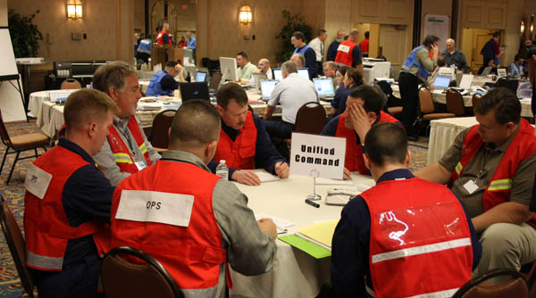
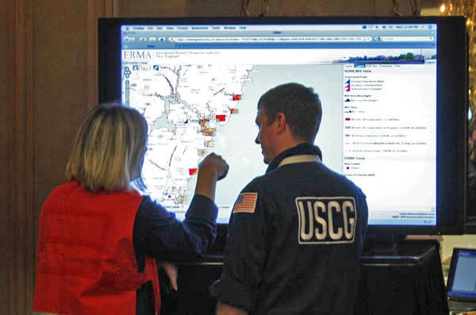
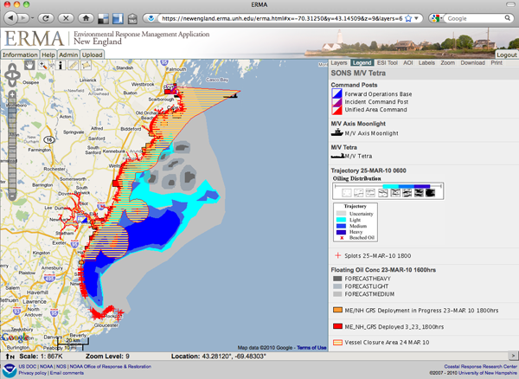
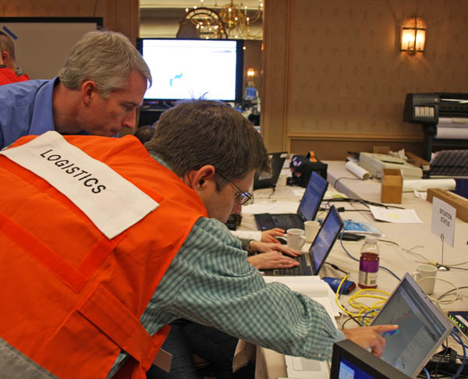
Notes:
The SONS drill simulated a ship leaking oil in the New England area. The bottom left is a screenshot from people using ERMA to make decisions about how to best deal with oil in the water. Bottom right shows just one instance of a team (in this case Logistics) talking to the ERMA team about how they can use the web interface to plan. Top right shows a spontaneous discussion that started with two USCG responders based on what they saw on a large ERMA LCD monitor setup in the corner. The top left image shows the unified command team working to make some sort of decision. I noticed that there wasn’t a single computer display involved in the process and there were no announcements to the room as a result of what ever it was that they were deciding. There wasn’t even a Blackberry in use during the meeting.

Slide 13
“Hotwash” – We were not ready
Faking data is difficult
Location names caused trouble
Little to no use of charts or the Coast Pilot
Which vessels were involved? Few had AIS
IT issues – printing challenges and overloaded wifi
Communication was dominated by rumors and note passing like in high schools (before texting)
Field personnel need mobile data input devices
Notes:
A “hotwash” is a the process of figuring out the areas that need improving, detailing them, and figuring out a strategy on how to move forward. Here are some of my observations from my SONS experience that I prepared to give back to NOAA based on what I saw. I was just an observer, so I might have missed some important processes, but my basic conclusion was that the integrated team (NOAA, USCG, commercial entities and ERMA) were just not ready for the rapid response required to contain a spill. It is really hard to create a test realistic enough to get people to act as if there is a real emergency going on. I’ve seen how hard it is for NASA with Operational Readiness Tests (ORTs). The pressure of a real spill was definitely not present in the atmosphere of the room. Watching people trying to get information from the field into GIS systems and ERMA was as expected. People taking notes from voice communication make mistakes or they might not know the proper spelling of challenging local names.
http://schwehr.org/blog/archives/2010-03.html#e2010-03-25T19_00_16.txt
http://www.delicious.com/goatbar/sons

Slide 14
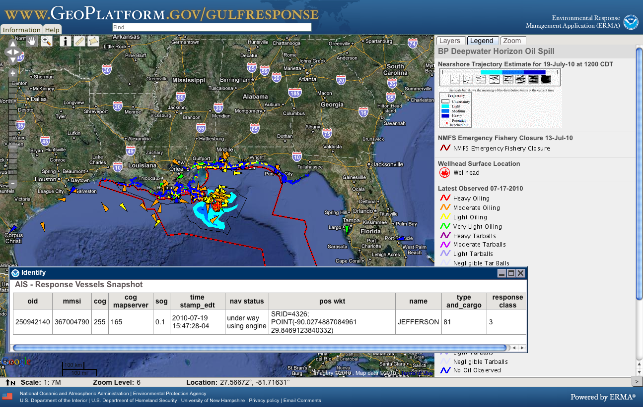
Deepwater Horizon
Notes:
And by July the team had a fully functioning site that had been cloned for the public and hosted by NOAA’s Web Operations Center (WOC).
http://www.woc.noaa.gov/

Slide 15
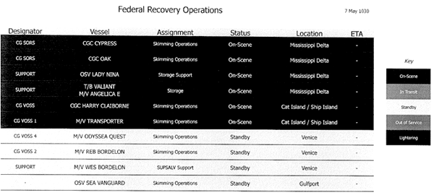
Challenges of knowing which ships
Notes:
Trying to figure out which ships are involved with the oil spill response effort and what their roles are was challenging. In the initial phases, I got a lot of the ships by watching the news on TV, checking images posted to Flickr and talking on the phone to anyone I could get ahold of. This is one of the better response ship lists that I got. I got lists of hundreds of ships all without MMSI or basic vessel information. Most of these turned out to be smaller vessels without AIS. Many of the vessels had names that were ambiguous with several vessels in the area that match the name. I found a few response vessels with improper names and even response vessels with invalid MMSIs. These obstacles make tracking very challenging.

Slide 16
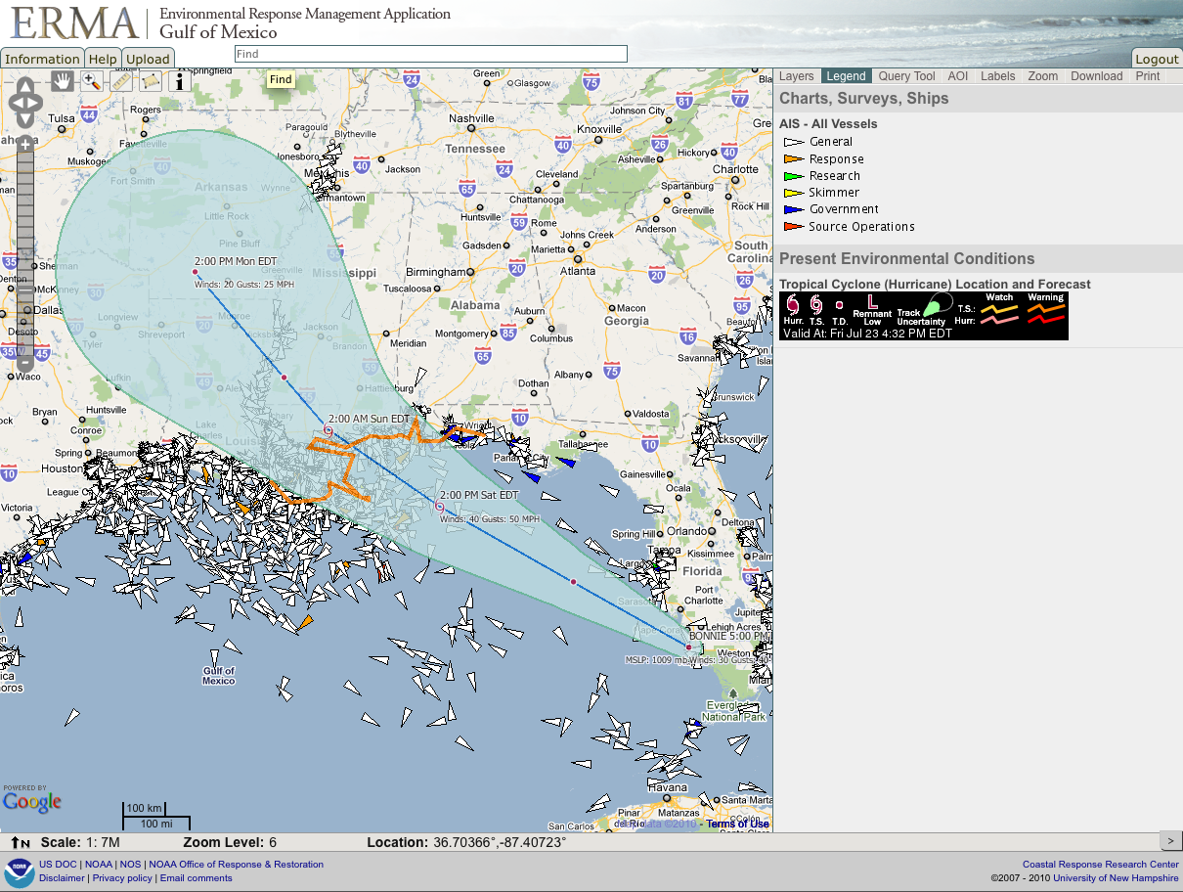
Notes:
Here is an even better example showing hurricane Bonnie that threatened to seriously disrupt cleanup operations. Thankfully, this hurricane came into the area smaller than it could have been. Here, ERMA can be used to monitor ships as they pull out of the way of the storm.

Slide 17
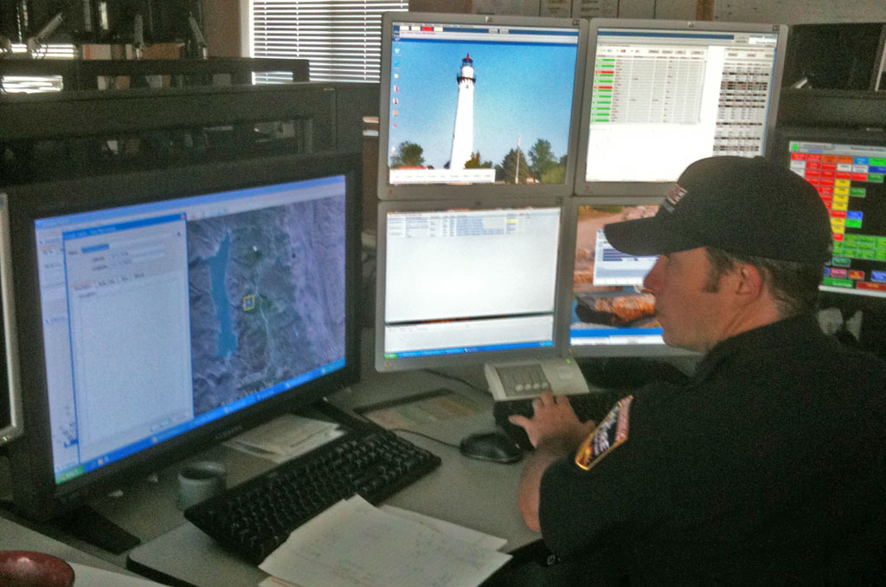
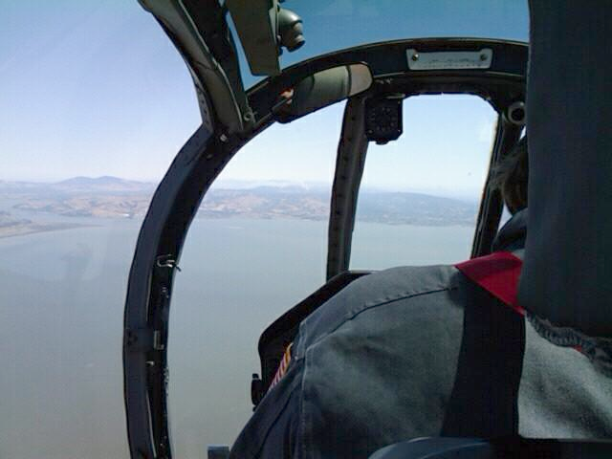
See also: Open Data Kit
Notes:
Here, a pilot has taken a picture while out in a plane heading to a fire (inset image). The phone automatically sends the image back to a server with geotagging information included. The server builds a Google Earth visualization that the officer in charge is able to use to follow the fire from the office. The goal is to put as much of the task into the software and free up the team from having to verbally pass as much information. This work done at NASA Ames Research Center. Project lead: Trey Smith. See also: http://opendatakit.org/
Workstation photo by Kurt Schwehr
Airborne photo by Cal Fire pilot

Slide 18
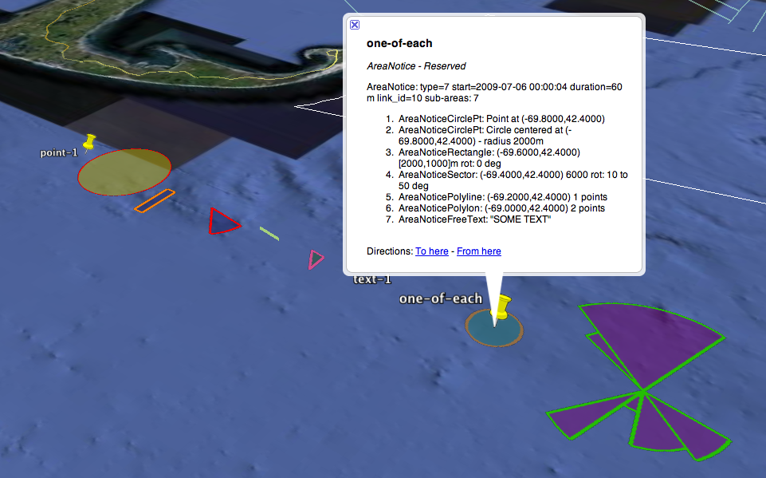
IMO AIS Binary Message – Area Notice RTCM and IMO Circular 289
Notes:
This transmission capability will allow systems to send out locations of oil, area closures, and so forth. Ships in the area will be able to automatically display this information without bothering the mariners using the display. CCOM has participated in specification of the new AIS messages and run the Right whale AIS notice Project (RAP) for the Boston approaches.
http://vislab-ccom.unh.edu/~schwehr/papers/2010-IMO-SN.1-Circ.289.pdf
http://www.listenforwhales.org/
http://vislab-ccom.unh.edu/~schwehr/papers/2009-mcgillivary-IEEEOceans-MTS.pdf

Slide 19
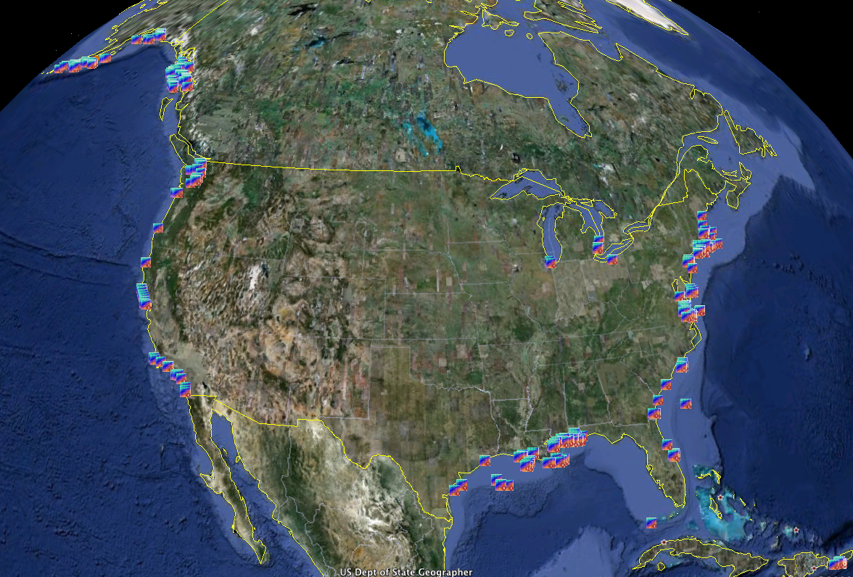
Bathymetric Attributed Grids
Notes:
NOAA has been working hard to release hydrographic surveys as BAGs. These are great data products, but are primarily focused on shipping lanes. Trouble usually happens outside of shipping lanes.
BAGs website: http://www.opennavsurf.org/
http://www.youtube.com/watch?v=7fOTlqqQ5O4

Slide 20
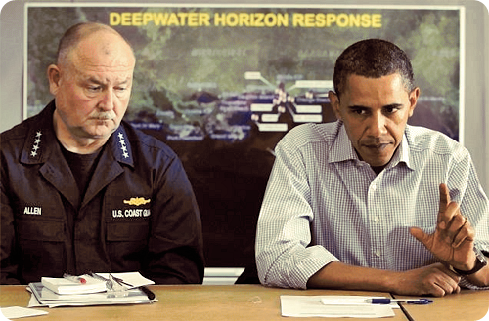
Are we ready for another oil spill as a community?
Probably
(for now)
Notes:
The long hall of the DWH incident has people tired, but the length of the incident has given systems and teams a chance to try to improve their processes. The problem is that every incident is unique, with its own challenges. As time goes on, we will loose the hard won skills that we acquired from the gulf incident.

Slide 21
Lessons for the future
Ships of all sizes should have AIS and there must be a way to track which ships are a part of a response
Have portable AIS systems ready to put on ships (suitcase version)
Know the bathymetry and be willing to collect your own if necessary. Have charts, the Coast Pilot and local names
Have a manual that you get to all of the team. People coming to the area don’t know the local names, physical layout, and available data / resources
Start using mobile devices to collect data – position and information. Avoid handwritten and voice communication to prevent confusion
Train with actual ships being virtually moved around
Get necessary data integrated into AOOS, ERMA and other systems before you are in a crisis. Unlike Deepwater Horizon, initial response time is usually critical
Train people to work with the data types before a crisis
PDFs and paper are not good primary delivery devices
Communication across all the teams makes or breaks the response
Notes:
There are many more lessons to be had, but here are some things that I believe will start discussion. Please post and/or send me lessons that you think we have or should learn.
e.g.
- We should have AIS from a couple response vessels forwarded through satellite to supplement normal stations

Slide 22
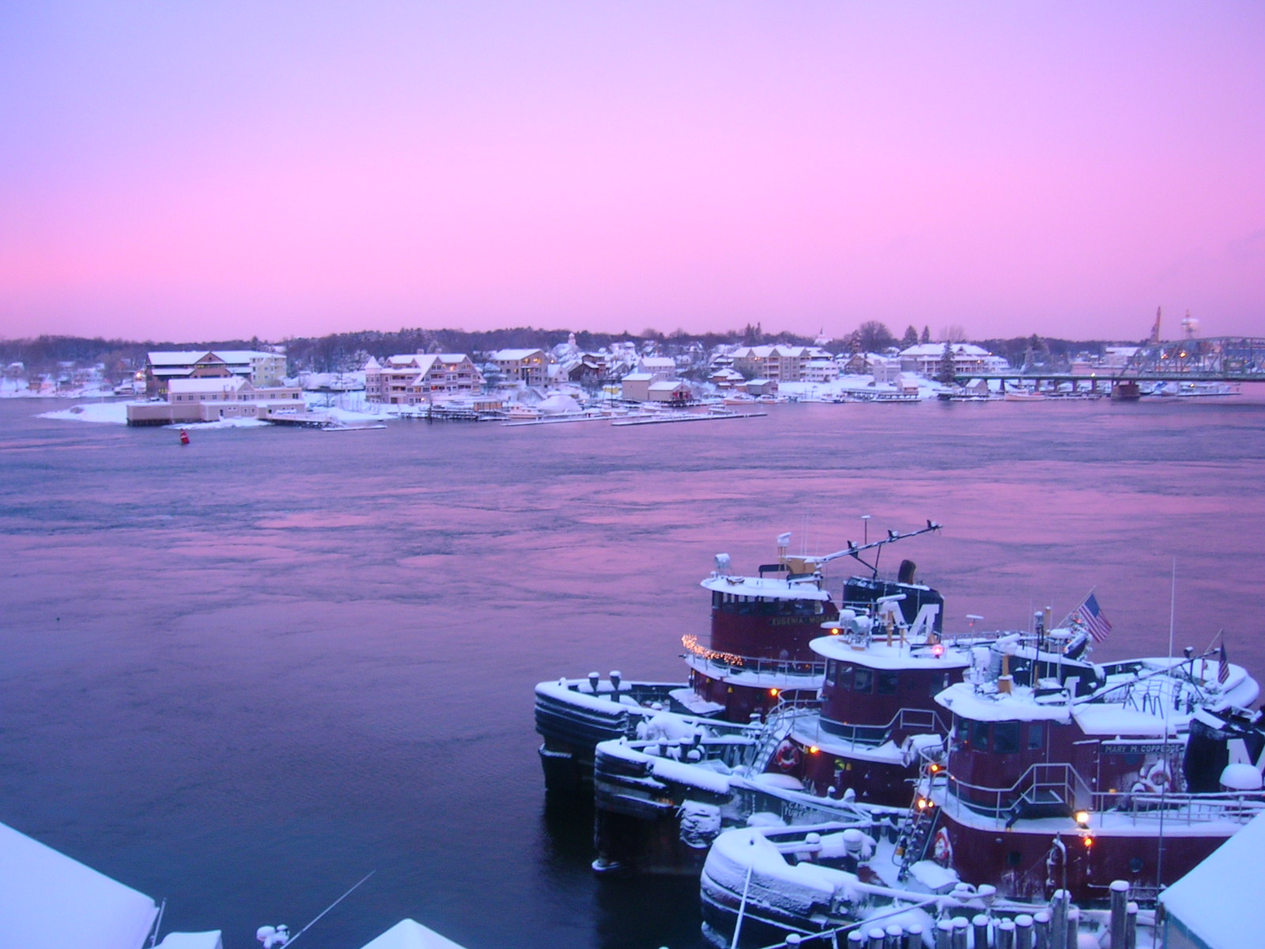
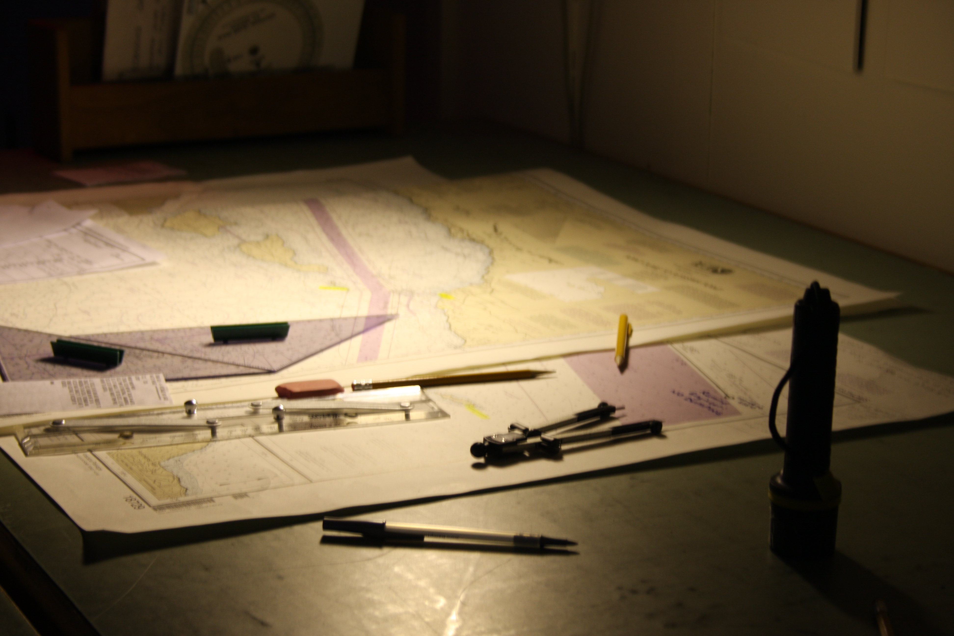
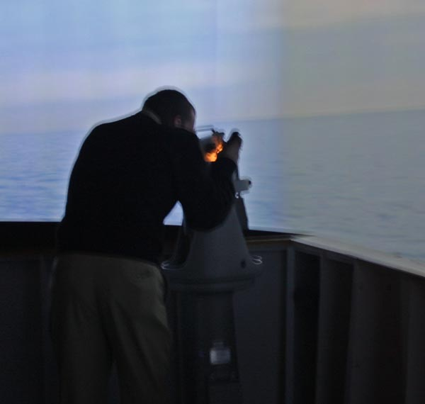
Thanks for listening! http://schwehr.org
Notes:
I work on the Chart of the Future where we are Charting the Future. Let’s all work towards keeping the ocean a great place to work and visit.

